Slide 1

Sellinger Applied Portfolio
Portfolio Review |Spring 2016

Slide 2

TABLE OF CONTENTS
Overview
Economic Conditions
Sector Summaries
Portfolio Strategy & Composition
  Growth
  Value
  Dividend
  ETF
Risk Analysis
Performance Review
Student Biographies

Slide 3

overview
Spring 2016
Overview
Economic Conditions
Portfolio Strategy & Composition
Sector Summaries
Risk Analysis
Performance Review
Student Biographies

Slide 4
Sellinger Applied Portfolio Overview
Background
Process
The Student-Managed Sellinger Applied Portfolio Fund “SAP Fund” was established to provide students with actual portfolio management experience. Students are exposed to various aspects of the portfolio management process, including asset valuation, diversification, portfolio optimization, asset selection, risk management, performance evaluation, and rebalancing . Each year the University may provide the SAP Fund with up to $500,000 to invest. These funds are a component of the University’s endowment.
The faculty hand selects 20 eligible students to manage the Sellinger Applied Portfolio Fund each semester. Member participation stems from team formation to analyze and pitch stock recommendations for the fund to invest in. Members in their entirety then vote on wither the recommendations pass and are implemented into the fund.
Team Formation
Team Pitches
Current events
Stock analysis
Sector coverage assigned
Stock recommendations
Students vote on recommendations
Investment Voting

Slide 5
Sellinger Applied Portfolio Overview
Objective
Select stocks that are undervalued and will outperform their industry and the S&P 500 index over the course of the investment period.
Asset Allocation Targets
Not more than 10% invested in any one stock
Not more than 20% invested in any one sector
Not more than 25% invested in any one index
40% Value | 40% Growth | 20% Dividend
No “sin” stocks
Benchmark
S&P 500 Index

Slide 6
Economic Conditions
Spring 2016
Overview
Economic Conditions
Portfolio Strategy & Composition
Sector Summaries
Risk Analysis
Performance Review
Student Biographies

Slide 7
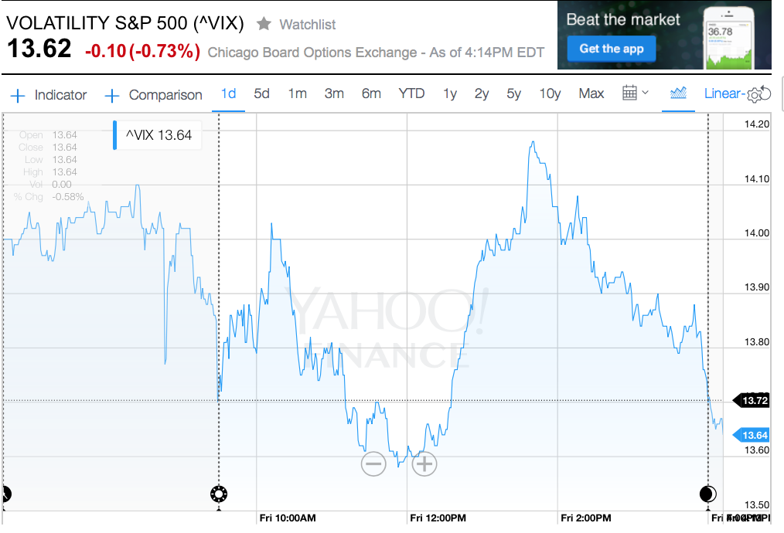
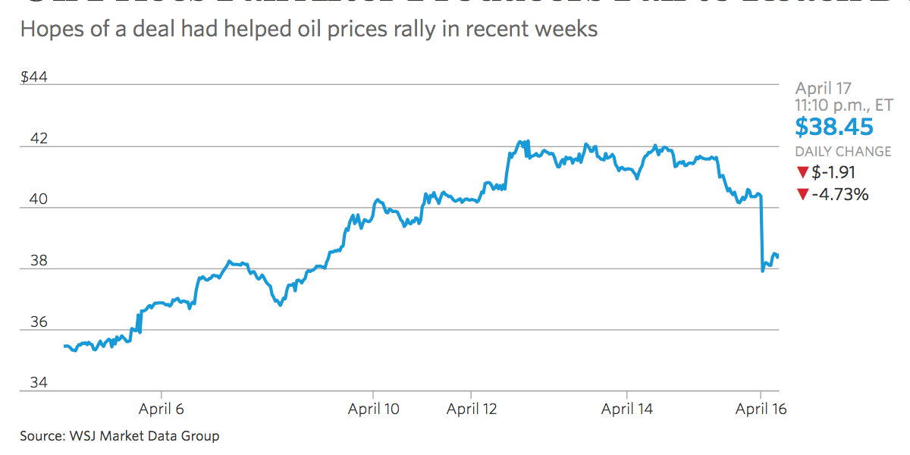
Market Overview
Two rate hikes left in the year
  Reduced from 4 hikes
Oil prices fall again
  No deal reached at Doha
  Prices slip from $40 to 38.45 by 4/17
Chinese Yuan strengthens against dollar
  Gained 121 basis points (6.4787) against dollar
  Based on weighted avg. of market maker prices

Slide 8
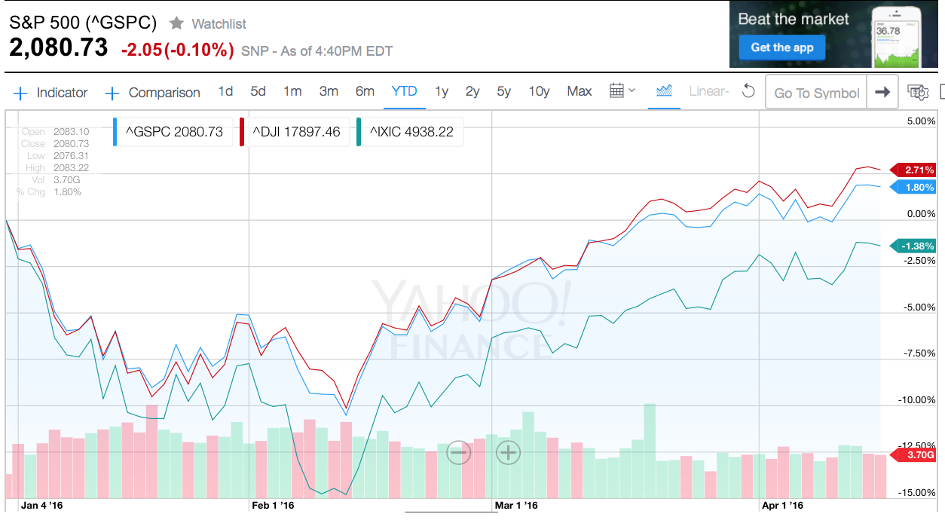
Major Indices Returns
Year to Date Return
S&P
+2.71%
DJI
+1.80%
NASDAQ
-1.38%

Slide 9
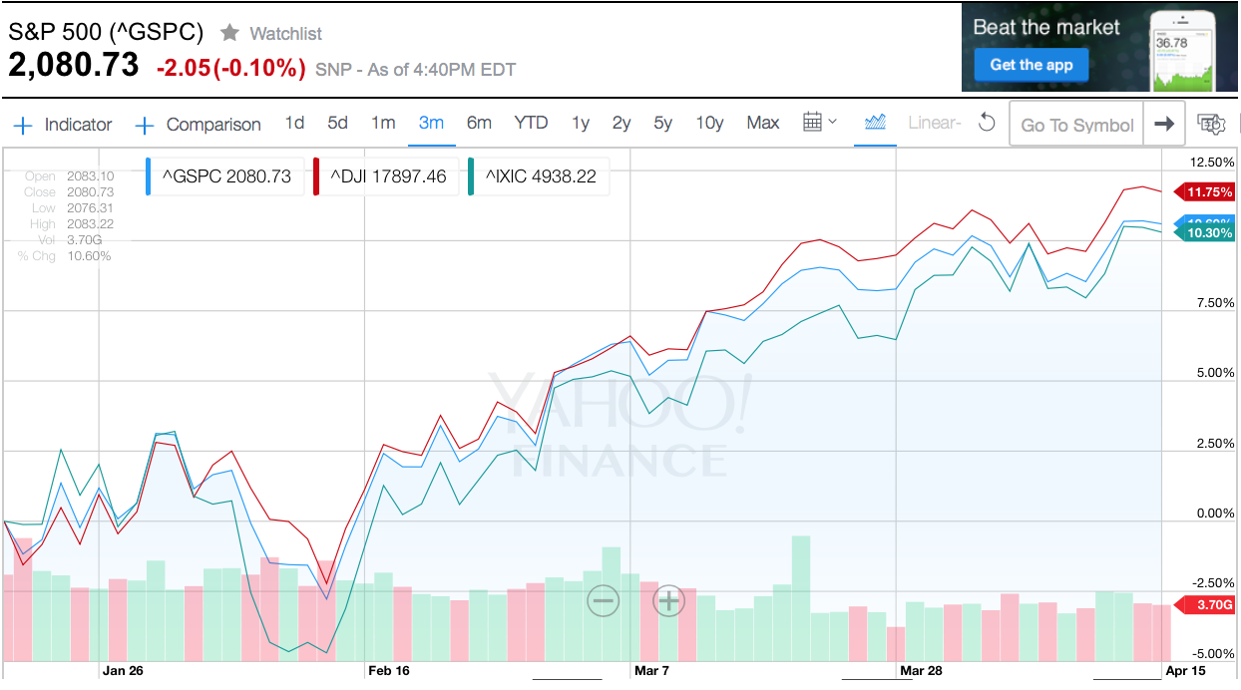
Major Indices Returns
3-Month Return
S&P
+10.6%
DJI
+11.75%
NASDAQ
+10.3%

Slide 10
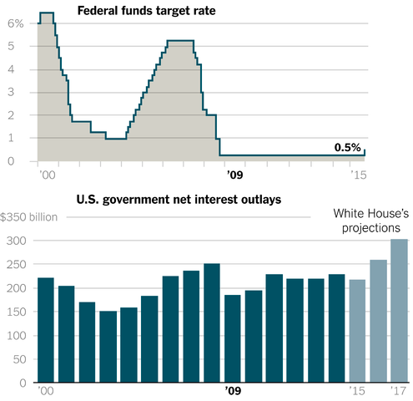
Federal Reserve Policy
Fed Policy Spring 2016
The Federal reserve recently increased interest rates from 0.25% to 0.50%.
What Happens When Fed Rate Increases?
Cost of borrowing for individuals and businesses increases.
Janet L. Yellen said the United States economy remained on track this Spring regardless of the rough start to the year.
Positive outlook for the economy.
Higher returns for savers.
Weak growth in other countries was being offset by lower borrowing costs.

Slide 11
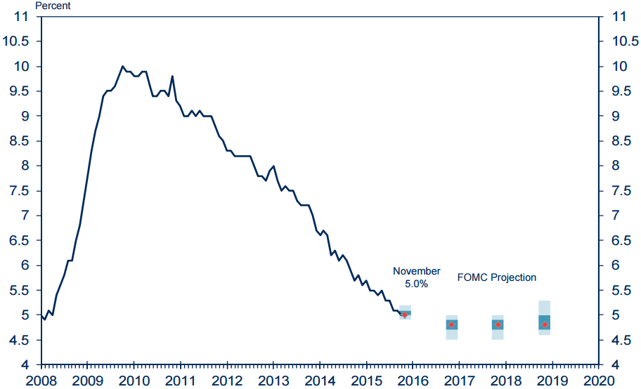
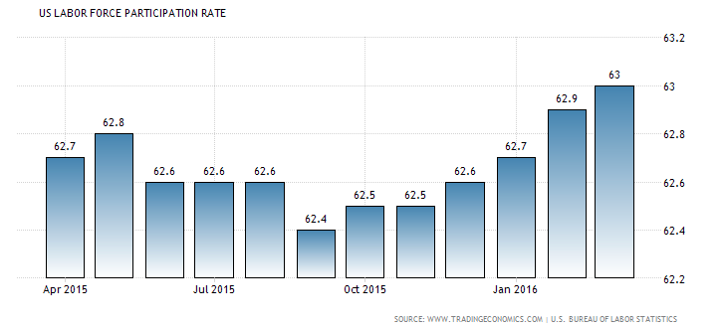
Employment
Unemployment rate as of March, 2016 is 5%, which supports the Fed’s reason to increase interest rates.
Nonfarm payroll employment rose by 215,000 in March of this year.
Nonfarm Payroll Employment
Unemployment
Labor Force Participation Rate
Movement of employment by Sector
Employment
increased in
retail trade,
construction, and
health care. Job losses occurred in manufacturing and mining.
The Labor Force Participation Rate in the USA has increased to 63% as of March.

Slide 12
International News
China
Investors say that China’s debt-fueled economy resembles the U.S. in 2008, before credit markets seized up and caused a global recession.
Housing values in first-tier cities have increased 62% in one year.
In March of this year, it was reported that exports were recovering and foreign exchange reserves increased since November of 2015
Europe
Economic recovery continued in the last quarter of 2015, with GDP increasing by 0.3%.
Labor reform in France caused strikes because of the worry of undermining worker’s rights and jobs security.
Middle East
With the collapse in oil prices, Saudi Arabia is expected to have a budget deficit of 13.5% of GDP this year.
There is no sign of end to the oil market weakness.
Continued infrastructure investment in anticipation of the World Expo 2020 should lead to growth of 2.7% in 2016.
Europe is facing a lot of political conflicts that could hurt the region’s recovery such as whether to remain in the EU and high inflow of refugees from outside countries.

Slide 13
Sector summaries
Spring 2016
Overview
Economic Conditions
Portfolio Strategy & Composition
Sector Summaries
Risk Analysis
Performance Review
Student Biographies

Slide 14
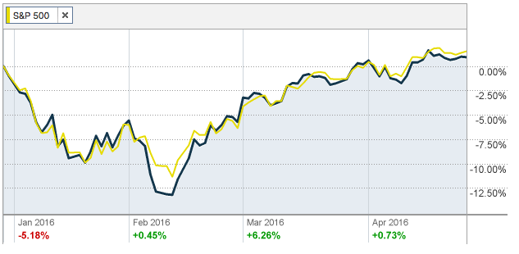
Consumer Discretionary
Performance (YTD):
1.92%
Portfolio:
Priceline (PCLN)
Starbucks (SBUX)
Whirlpool Corp. (WHR)
Time Warner Inc. (TWX)
New Media (NEWM)
Johnson Controls Inc. (JCI)
Hasbro (HAS)
Stocks to Watch:
Ford Motor Co. (F)
Companies in the Consumer Discretionary sector manufacture goods or provide services that people want to but don’t necessarily need. This sector tends to perform better in a healthy economic environment. This aligns with its current year-to-date return of 1.92%, underperforming the S&P 500 that has a YTD return of 2.51%.
Data on retail sales and consumer confidence suggest a still-cautious shopper, but these reports could underestimate what is actually occurring, as some services and experience-type items aren’t included in those numbers. Consumers seem to be cautious and underemployment is still a concern. However, The American consumer has shown a remarkable ability to overcome obstacles, and we're optimistic that will continue to be the case.

Slide 15
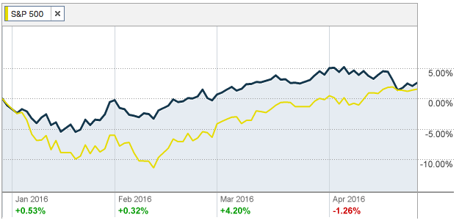
Consumer Staples
Performance (YTD):
3.70%
Portfolio:
Costco (COST)
Pepsico Inc. (PEP)
CVS Health Inc. (CVS)
Estee Lauder Inc. (EL)
Consumer Staples Sector SPDR ETF (XLP)
Stocks to Watch:
Procter & Gamble (PG)
Consumer Staples is considered to be a “defensive” sector, which is comprised of companies that manufacture and distribute essential products such as food, beverages, tobacco and household items. These companies’ stocks are non-cyclical, in which they remain stable throughout the various business cycles and are always in demand regardless of their price or the status of the economy. The estimated weight of Consumer Staples (XLP) in the S&P 500 is 10.04%.
The Consumer Staples sector has returned 3.70% Year-to-Date and has generally kept up with the market, with the S&P 500 returning 2.51%. With a recovering economy and a positive future outlook, retailers’ aggressive cost-cutting and lower energy and commodity prices, Consumer Staples stocks have benefited.

Slide 16
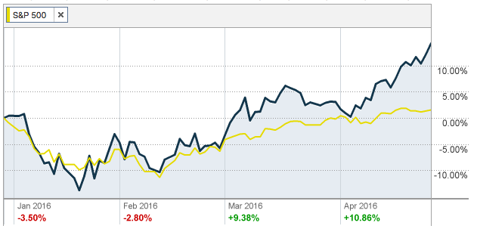
Energy
Performance (YTD):
13.78%
Portfolio:
Energy Select Sector SPDR ETF (XLE)
SeaDrill Partners LLC F (SDLP)
Stocks to Watch:
Chevron (CVX)
ExxonMobil (XOM)
The Energy sector is very volatile and includes companies that produce and distribute or supply energy. These stock companies explore or develop oil and gas reserves, and typically perform well during periods of high gas and oil prices. The estimated weight of Energy (XLE) in the S&P 500 is 7.19%.
The energy sector continues to be quite volatile, but so far this year the sector’s performance is roughly in line with the overall market. There are some fundamental factors supporting the energy sector including a decline in U.S. production growth and increased demand. For this reason, we have shifted our outlook to overweight, and the sector has returned 13.78% YTD.

Slide 17
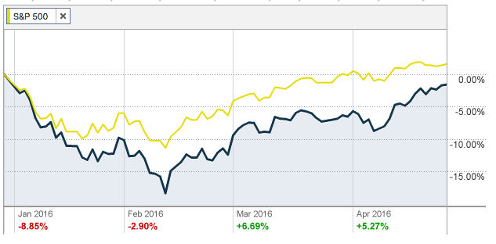
Financials
Performance (YTD):
-0.59%
Portfolio:
Regions Financial Co. (RF)
BlackRock (BLK)
MetLife, Inc. (MET)
Financial Select Sector SPDR ETF (XLF)
Stocks to Watch:
WisdomTree Investments (WETF)
Wells Fargo (WFC)
The Financial sector seeks to invest in stocks of companies operating in the financial sector including diversified financial services, insurance, banks, capital markets, real estate investment trusts, consumer finance, thrifts and mortgage finance, and real estate management and development.
The Financial sector posted negative returns year-to-date, underperforming the market with a return of -0.59%. Financial services companies have been very volatile over the past year, however, we’ve seen the sector bounce since mid-February as investors believe the sector will emerge as one of the better performers for the year. Government regulations and election rhetoric continue to pose a risk for the sector.

Slide 18
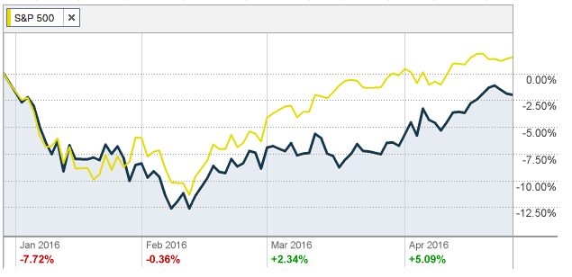
Healthcare
Performance (YTD):
-1.10%
Portfolio:
Abbott Laboratories (ABT)
Becton, Dickinson and Co. (BDX)
Anthem Inc. (ANTM)
Gilad Sciences Inc. (GILD)
Celgene Co. (CELG)
Merck & Co. (MRK)
Johnson & Johnson (JNJ)
Sucampo Pharmaceuticals (SCMP)
Stocks to Watch:
Eli Lilly (LLY)
The Healthcare ETF seeks to invest in stocks of companies operating in the healthcare sector including pharmaceuticals, health care equipment and supplies, health care providers and services, biotechnology, life sciences tools and services, and health care technology. This sector is less sensitive to economic cycles because the demand for the healthcare goods and services is relatively constant.
Recently, the healthcare sector has underperformed, though demand for healthcare products and services is on the rise. Additionally, Balance sheets in the healthcare sector remain flush with cash, increasing the possibility of higher dividend payments, share-enhancing stock buybacks, and mergers and acquisitions. However, increased government regulation, potential pricing regulation, and fiscal policy concerns have caused the sector to take a hit.

Slide 19
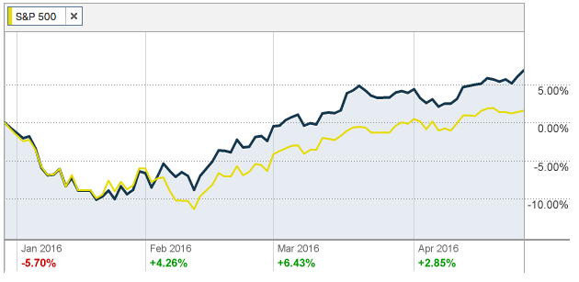
Industrials
Performance (YTD):
7.60%
Portfolio:
Stanley Black & Decker Inc. (SWK)
Southwest Airlines (LUV)
Industrial Select Sector SPDR ETF (XLI)
Stocks to Watch:
China Eastern Airlines (CEA)
Boeing (BA)
The Industrials sector is comprised of a wide variety of firms including but not limited to firms involved in construction, aerospace, defense, machinery, tools, and several other industries. The sector is largely dependent on supply and demand for building construction as well as the demand for manufactured products.
The Industrial sector shows returns of 7.60% year-to-date. Global manufacturing has stumbled of late, with weakness in China feeding into soft manufacturing activity in the U.S. Still, the overall domestic picture looks decent, as lower energy costs help bolster some areas of the sector.

Slide 20
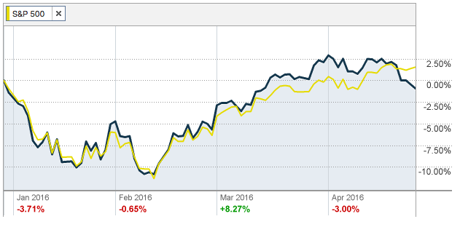
Information Technology
Performance (YTD):
0.49%
Portfolio:
Texas Instruments (TXN)
Apple Inc. (AAPL)
Broadcom (AVGO)
Facebook (FB)
Flir Systems Inc. (FLIR)
Microsoft, Corp. (MSFT)
Intel Corp (INTL)
Cisco (CSCO)
Tech ETF (XLK)
Stocks to Watch:
The Index includes companies from the following industries: computers & peripherals; software; diversified telecommunication services; communications equipment; semiconductor & semiconductor equipment; internet software & services; IT services; electronic equipment, instruments & components; wireless telecommunication services; and office electronics.
The technology sector has posted a nice rebound over the past couple of months after a tough start to the year. The Information Technology sector contributed to positive performance, with a 0.49% return year-to-date, underperforming the S&P 500.

Slide 21
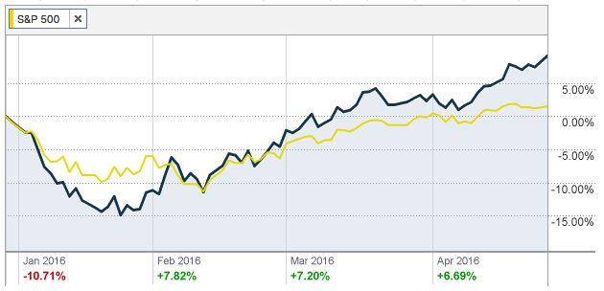
Materials
Performance (YTD):
10.16%
Portfolio:
No allocation to this sector
Stocks to Watch:
Alcoa (AA)
DuPont (DD)
Methanex (MEOH)
The Materials sector consists of companies that develop, manufacture and process chemicals and plastics, as well as mining metals and minerals, and harvesting forests. This sector is sensitive to the phases of the business cycle and state of the economy, because these companies supply materials for construction, which is a process that is greatly dependent on a strong economy. The estimated weight of the Materials Sector (XLB) in the S&P 500 is 2.94%.
Materials Year-to-Date return is -10.16%, which underperforms the market S&P500 of 2.51%. It took a beating to start the year, as the commodity price slide continued in response to concern about slowing Chinese economic growth; however, a recent bounce in the group has actually brought the year-to-date performance slightly above the market.

Slide 22
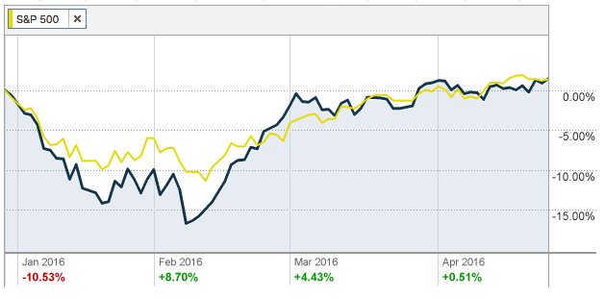
Telecommunications Services
The Telecommunication Services sector includes companies that transmit data through communication services using wireless networks, satellite, cable and Internet. They provide the communication and transmission of data to be sent all throughout the world using phone or Internet, both wired and wireless networks. The estimated weight of Telecommunication Services (XTL) in the S&P 500 is about 2.62%.
Telecommunication Services Year-to-Date have returned 2.59% versus the index, S&P 500 return of 2.51%. The sector is driven by fierce competition, with new ways of communicating continually entering the market, along with consistent, and expensive upgrade cycles. This reduces the traditional defensive appeal of the telecom sector. However, the group has done quite well so far this year and is one of the top performers to this point in 2016.
Performance (YTD):
2.59%
Portfolio:
No allocation to this sector
Stocks to Watch:
CenturyLink (CTL)
Frontier Communication (FTR)

Slide 23
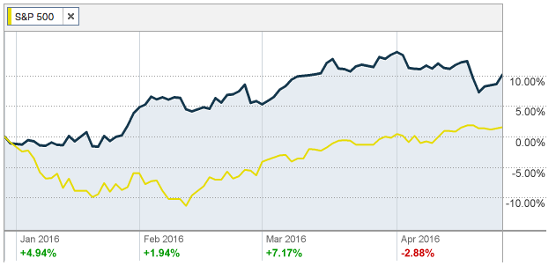
Utilities
Performance (YTD):
11.37%
Portfolio:
No allocation to this sector
Stocks to Watch:
Calpine Corporation (CPN)
Consolidated Water Co. Ltd (CWCO)
Duke Energy Corp. (DUK)
Utilities is another “defensive” sector that is comprised of a category of stocks in a variety of industries such as electric, gas and water. These companies engage in producing and delivering electric power, natural gas, water, renewable energy and other utility services. The estimated weight of the Utilities Sector (XLU) in the S&P 500 is 2.89%.
The Utilities sector has outperformed the S&P 500 Year-to-Date with 11.37% return versus the 2.51% return of the S&P 500. The utilities sector has historically been underweighted by the S&P 500 and has generally been overlooked by the SAP portfolio. However, utility stocks started off the year quite well, as investors worried about a possible US recession.

Slide 24

Portfolio strategy & composition
Spring 2016
Overview
Economic Conditions
Portfolio Strategy & Composition
Sector Summaries
Risk Analysis
Performance Review
Student Biographies

Slide 25
Growth Strategy Overview
To find stocks expected to grow faster than their industry peers
BUY CRITERIA
Conservative Mentality | Expect stock to perform better than the Industry
Revenue Growth | Industry Average and forecasted to continue to grow
Strong Earnings | 5 years of CAGR
ROE | ≥ 15% and > Industry Average
PEG | ≤ 1.2 and < Industry Average
Debt/Equity | < 1.5 (or Acceptable Interest Coverage Ratio when D/E >1.0)
SELL CRITERIA
Price | Price reaches 10% below target price or 20% above purchase price
Leadership | The company’s leadership position changes
Business Fundamentals | Business fundamentals deteriorate
Company slowdown | Slowing unit volume, revenue decline, weak earnings, etc.
Alternative Investments | Superior investment alternatives are identified

Slide 26
Growth Strategy Overview
Stop Loss Criteria
Acquisitions
Given the increase in volatility surrounding the economic uncertainty in China, we decided not to use stop losses this semester.
Sucampo Pharmaceuticals, Inc.
Broadcom, Ltd.

Slide 27

Growth Strategy Position Changes
SUCAMPO PHARMACEUTICALS, INC. | SCMP
Buy Criteria
Industry Average
SCMP
Position
1000 Shares | $11,260.00
Revenue growth
36.30%
36.70%
Sucampo Pharmaceuticals, Inc. conducts research focused on medical applications of prostones towards the treatment gastrointestinal inflammations and diseases.
Sucampo Pharmaceuticals, Inc.’s mission statement is to improve the lives of patients, caregivers, and their families through scientific exploration and innovation to solve unmet medical needs.
5 years of CAGR
-1.2%
10.9%
ROE
20.30%
34.41%
PEG
1.2
0.39
Debt/ Equity
0.9
0.11

Slide 28

Growth Strategy Position Changes
BROADCOM LTD. | AVGO
Buy Criteria
Industry Average
AVGO
Position
123 Shares | $19,190.46
Revenue growth
-2.8%
59.90%
Broadcom Ltd. offers semiconductor solutions and their products include broadband, processors, wireless, and ethernet. These products can be used for data center networking, home connectivity, telecommunications equipment, smartphones, power generation and alternative energy systems.
Broadcom Limited is a diversified global semiconductor leader built on 50 years of innovation, collaboration and engineering excellence.
5 years of CAGR
29.20%
26.70%
ROE
0.20%
35.00%
PEG
0.69
0.69
Debt/ Equity
3.6
83.8

Slide 29
Value Strategy Overview
To find stocks priced less than their intrinsic value
BUY CRITERIA
Price/Sales | < Industry Average
Price/Book | < Industry Average
Dividends | > Industry Average
Free Cash Flow | Positive
SELL CRITERIA
Mergers or acquisitions | Any news in regards to M&A activity
Earnings | Significant restatement
Executive Management | Changes to management
Price Targets | Exceeds initial price target
Price | Trending downwards towards a stop loss mark

Slide 30
Value Strategy Overview
Stop Loss Criteria
Acquisitions
Whirlpool Corporation
Time Warner, Inc.
New Media, Inc.
Johnson Controls, Inc
Hasbro, Inc.
Johnson & Johnson
Microsoft, Corp.
Flir Systems, Inc.
Seadrill Partners, LLC
Given the increase in volatility surrounding the economic uncertainty in China, we decided not to use stop losses this semester.

Slide 31

Value Strategy Position Changes
WHIRLPOOL CORPORATION | WHR
Buy Criteria
Industry Average
WHR
Position
76 Shares | $13,904.20
Price/ Sales
1.7
0.56
Whirlpool Corporation manufactures and markets home appliances and related products worldwide. The companys principal products include laundry appliances, refrigerators and freezers, cooking appliances, dishwashers, mixers, and other portable household appliances.
Whirlpool’s mission is to “Create Demand and Earn Trust Every day.” They are the number one major appliance manufacturer in the world, with approximately $21 billion in annual sales, 97,000 employees and 70 manufacturing and technology research centers in 2015.
Price/ Book
3.54
2.58
Divided Yield
1.90%
2.17%
Positive Cash flow
-
$ 952.25 M

Slide 32

Value Strategy Position Changes
TIME WARNER, INC. | TWX
Buy Criteria
Industry Average
TWX
Position
170 Shares | $12,506.90
Price/ Sales
2.26
2.05
Time Warner has three main business segments: Turner, Home Box Office, and Warner Bros. Turner is in charge of cable networks and digital media properties. Home Box Office is premium pay television and streaming services. Warner Bros. is television, feature film, and home video.
Warner Bros. is the number one producer of primetime television series. In 2015, HBO received a record 43 Emmys, the most of any network, for the 14th year in a row. In 2015, Warner Bros released 24 original films.
Price/ Book
8.25
2.38
Divided Yield
1.85%
1.98%
Positive Cash flow
-
$ 3.43 B

Slide 33

Value Strategy Position Changes
New Media Investment Group, Inc. | NEWM
Buy Criteria
Industry Average
NEWM
Position
415 Shares | $11,991.88
Price/ Sales
1.40
0.6
New Media is focused primarily on investing in a high quality, diversified portfolio of local media assets, and on growing existing advertising and digital marketing businesses.
New Media creates stockholder value through growth by expanding digital marketing services business, growing our online advertising business, and pursuing strategic acquisitions of high quality local media assets.
Price/ Book
3.40
1.1
Dividend Yield
1.30%
8.17%
Positive Cash flow
-
$105 M

Slide 34

Value Strategy Position Changes
HASBRO, INC. | HAS
Buy Criteria
Industry Average
HAS
Position
70 Shares | $5,581.10
Price/ Sales
2.6
1.90
Hasbro, Inc. is the number two toy maker in the United States. They are known from toys and games to television programming, motion pictures, digital gaming and a comprehensive lifestyle licensing program.
Hasbro, Inc. has more than 90 years of innovation and products sold in more than 120 countries. Hasbro is a global company committed to Creating the World's Best Play Experiences, by leveraging its beloved brands.
Price/ Book
3.0
5.07
Divided Yield
1.40%
2.72%
Positive Cash flow
-
$410.42 M

Slide 35

Value Strategy Position Changes
Johnson & Johnson | JNJ
Buy Criteria
Industry Average
JNJ
Position
112 Shares | $12,063.52
Price/ Sales
1.8
4.5
Johnson & Johnson is an American multinational medical devices, pharmaceutical and consumer packaged goods manufacturer founded in 1886. Their main products include the Band-Aid line of bandages, Tylenol medications, Johnson’s baby products, Neutrogena skin and beauty products, Clean & Clear facial wash, and Acuvue contact lenses.
The corporation includes some 250 subsidiary companies with operations in over 57 countries and products sold in over 175 countries. The company operates is three broad divisions; Consumer Healthcare, Medical Devices and Pharmaceuticals.
Price/ Book
3.84
4.12
Divided Yield
2.54%
2.80%
Positive Cash flow
-
$15.82 B

Slide 36

Value Strategy Position Changes
Microsoft | MSFT
Buy Criteria
Industry Average
MSFT
Position
200 Shares | $10,223.16
Price/ Sales
5.51
4.58
Microsoft is an American multinational technology company headquartered in Redmond, Washington, that develops, manufactures, licenses, supports and sells computer software, consumer electronics and personal computers and services.
Its best known software products are the Microsoft Windows line of operating systems, Microsoft Office office suite, and Internet Explorer and Edge web browsers. Its flagship hardware products are the Xbox game consoles and the Microsoft Surface tablet lineup.
Price/ Book
5.35
5.18
Divided Yield
1.33%
2.67%
Positive Cash flow
-
$1.7 B

Slide 37

Value Strategy Position Changes
FLIR SYSTEMS, INC. | FLIR
Buy Criteria
Industry Average
FLIR
Position
484 Shares | $15,792.92
Price/ Sales
5.63
2.79
Flir Systems, Inc. designs, develops, manufactures, markets, and distributes technologies that enhance perception and awareness. Flir operates in six major segments: Surveillance, Security, Detection, Instruments, OEM and Emerging Markets, and Maritime Segment.
Flir Stystems, Inc. is the leading developer of advanced proprietary technology sensor systems.
Price/ Book
5.49
2.65
Divided Yield
1.30%
1.44%
Positive Cash flow
-
$207.58 M

Slide 38

Value Strategy Position Changes
Johnson Controls, Inc. |JCI
Buy Criteria
Industry Average
JCI
Position
210 Shares | $7,971.60
Price/ Sales
1.7
.68
Johnson Controls Inc creates products, services and solutions to optimize energy and operational efficiencies of buildings; lead-acid automotive batteries and batteries for hybrid and electric vehicles; and interior systems for automobiles.
Price/ Book
3.54
2.36
Divided Yield
1.9
2.8%
Positive Cash flow
-
Yes

Slide 39

Value Strategy Position Changes
Seadrill Partners, LLC | SDLP
Buy Criteria
Industry Average
SDRL
Position
1600 Shares | $5,496.00
Price/ Sales
1.1
0.2
Seadrill Partners LLC is a growth-oriented limited liability company recently formed by Seadrill Limited to own, operate and acquire offshore drilling rigs. Their drilling rigs are under long-term contracts with major oil companies such as Chevron, Total, BP and ExxonMobil.
Seadrill is one of the world's largest international offshore drilling contractors, and will be motivated to facilitate Seadrill Partners’ growth because of its significant ownership interest.
Price/ Book
1.84
0.36
Divided Yield
5.82%
59.9%
Positive Cash flow
-
$841.2 M

Slide 40
Dividend Strategy Overview
To find stocks fairly priced and offering a dividend yield greater than the S&P 500
BUY CRITERIA
Dividend Yield | ≥ SPDR S&P Dividend ETF
Quick Ratio | ≥ Industry Average
Cash Dividends | Positive total cash dividends paid annually
Positive Total Cash | From investing and operating activities
Constant Dividend | Yes
Dividend Growth | Historical and potential dividend growth
SELL CRITERIA
Dividends | Dividends are cut
Free Cash Flow | Diminishes or is no longer positive
Alternative Investments | Superior investment alternatives are identified

Slide 41
Dividend Strategy Overview
Stop Loss Criteria
Acquisitions
Given the increase in volatility surrounding the economic uncertainty in China, we decided not to use stop losses this semester.
PepsiCo, Inc.
Regions Financials Corporations

Slide 42

Dividend Strategy Position Changes
PepsiCo, Inc. | PEP
Buy Criteria
Industry Average
PEP
Position
50 Shares | $4,856.50
Quick Ratio
0.56
0.97
PepsiCo, Inc. operates as a food and beverage company worldwide. The company has a portfolio of brands, including Frito-Lay, Gatorade, Pepsi-Cola, Quaker, and Tropicana.
The company, through its operations, authorized bottlers, contract manufacturers and other third parties, makes, markets, distributes, and sells various beverages, foods, and snacks, serving customers and consumers in approximately 200 countries and territories.
Dividend Yield
2.61
2.80
Positive Free Cash FLow
1.31 Billion
7.81 Billion
1 Year Beta
0.79
0.81

Slide 43

Dividend Strategy Position Changes
Regions Financial Corporation |RF
Buy Criteria
Industry Average
RF
Position
1,235 Shares | $10,003.50
Quick Ratio
N/A
N/A
Regions Financial Corporation, with $126 billion in assets, is a member of the S&P 500 Index and one of the nation's largest full-service providers of consumer and commercial banking, wealth management, mortgage and insurance products and services.
Regions serves customers across the South, Midwest and Texas, and through its subsidiary, Regions Bank, operates approximately 1,600 banking offices and 2,000 ATMs
Dividend Yield
2.84
2.92
Positive Free Cash FLow
2.44 Billion
1.20 Billion
1 Year Beta
1.11
1.21

Slide 44
ETF Strategy Overview
BUY CRITERIA
 | Growth | Value
Average 3 Month Volume | ≥ 600MM Shares | ≥ 600MM Shares
Portfolio P/E | 14 ≤ P/E ≤ 22 | ≤ S&P 500
Beta (3 years) | ≤ 1.25 | ≤ 1
Net Assets | ≥ $250MM | ≥ $250MM
Expense Ratio | ≤ 0.9% | ≤ 0.9%
SELL CRITERIA
Price/Earnings | Does not meet criteria
Price | Drops 10%
Position Change
All Spider ETFs were purchased or sold in order to utilize the cash in our portfolio while waiting for investment decisions to be made.

Slide 45
Unique Attributes
Sucampo Pharmaceuticals, Inc.
One of the leading innovators of medicine in gastroenterology
Broadcom, Ltd.
Merger with Avago expected to result in a “semiconductor powerhouse” due to Avago’s strong growth in profitables and aggressive M&A strategy combined with Broadcom’s market leadership in networking.
Whirlpool Corporation
New washing cycle for men who don’t separate their colors
Time Warner, Inc.
In 2015, HBO received a record 43 Emmys, the most of any network, for the 14th year in a row. In 2015, Warner Bros released 24 original films.
New Media, Inc.
More than 84% of their daily newspapers have been published for more than 100 years and 100% have been published for more than 50 years.
Johnson Controls, Inc.
Their merger with Tyco International announced in January 2016 will save about $150 million per year in taxes.
Hasbro, Inc.
Regions Financial Company
The Hub Network, launched in 2010, is an award- winning, multi-platform joint venture between Hasbro, Inc., and Discovery Communications that brings Hasbro into the television business in the U.S.
Regions is the only member of the Fortune 500 headquartered in Alabama and was ranked by Business Insider as the largest company in the state.

Slide 46
Unique Attributes
Flir Systems, Inc.
FLIR Systems is the world's largest commercial company specializing in the design and production of thermal imaging cameras, components and imaging sensors.
Seadrill Parners, LLC
As of 2015, founder John Fredriksen owned 119 million shares of the company.
PepsiCo, Inc.
In December 2005, PepsiCo surpassed The Coca-Cola Company in market value for the first time in 112 years since both companies began to compete.
Priceline
Has reported operating margins over 20% in 14 of the last 20 quarters, while its closest competitor has generated similar margins once over the same time frame.
Starbucks Corporation
Has added an average of 2 stores on a daily basis since 1987 and at $300 million, Starbucks spends more on healthcare insurance for its employees than on beans.
Costco
Buys up half of the world's supply for cashews. Costco makes virtually no profit on the stuff its sells-80% of company gross profit comes from member fees.
CVS
In 2014, CVS Pharmacy’s filled 756 million retail prescriptions in the United States, which accounted for 21% of the domestic retail pharmacy market.
Estee Lauder Co, Inc.
Owns over 30 different popular beauty brands with a multitude of distribution channels as well as a strong presence overseas.

Slide 47
Unique Attributes
Abbott Laboratories
Currently India’s largest healthcare products company.
Becton, Dickinson, and Company
About two-thirds of all insulin globally is delivered through a Becton injection device.
Anthem, Inc.
The largest for-profit managed health care company in the Blue Cross and Blue Shield Association.
Gilead Sciences, Inc.
Discovers and develops a variety of antiviral drugs that treat HIV, hepatitis B, hepatitis C and influenza.
Merck & Co.
They maintain high cash flows to support R&D costs needed for new drugs. Their future focus is on areas with unmet medical needs, such as immuno-oncology.
Stanley, Black & Decker
The #1 supplier of power and hand tools in the world and the second largest U.S. supplier of commercial electronic security devices.
Southwest Airlines
The largest budget airline in the U.S. and second largest domestic carrier by traffic. Main company focus is customer service.
Texas Instruments
Dividend payout has never been cut in the company’s history.

Slide 48
Unique Attributes
Facebook
With 1.49 billion users, the number of people using Facebook exceeds the population of China.
Intel Corporation
The largest semi-conductor manufacturer in the world (based on market capitalization).
Cisco
They provide intelligent solutions through connecting highly distributed data. They own many of their suppliers, which reduces the risk of obtaining materials.
Johnson & Johnson
Is the top market cap healthcare stock on Wall Street and remains one of the most diversified healthcare companies.
Microsoft, Corp.
Microsoft’s mobile first, cloud first reorganization provides a more cohesive strategy to deliver services in a world changing to cloud and mobility from PC and server.
BlackRock
The world’s largest asset management firm with $4.77 trillion in assets under management.
Metlife, Inc.
Leading global provider of insurance, annuities and employee benefit programs. Holds leading market positions in the U.S., Japan, LATAM, and EMEA.
Apple, Inc.
According to 2013 data, Apple earns $71,523 of profit per minute.

Slide 49
Risk Analysis
Spring 2016
Overview
Economic Conditions
Risk Analysis
Sector Summaries
Portfolio Strategy & Composition
Performance Review
Student Biographies

Slide 50
Portfolio Risk Analysis: Standard Deviation
SAP
σ = 1.18
S&P 500
σ =1.0572
VS.
Sharpe Ratio
S&P 500
0.039
SAP
0.0548
>
NSDQ
0.038
DJI
0.029

Slide 51
Portfolio Risk Analysis: Beta
SAP
β 1.06
S&P 500
β 1.0
VS.
Seadrill, Avago, Sucampo
Highest betas in the Spring 2016 SAP fund
High risk, but not the highest reward
Surprisingly, the stocks in our portfolio with the highest betas represented the highest risks, but did not necessarily generate the highest returns

Slide 52
Covariance Matrix
 | PCLN | SBUX | WHR | TWX | NEWM | JCI | HAS | COST | PEP | CVS | EL | BLK | MET | RF | ABT | BDX | ANTM | GILD | MRK | JNJ | SCMP | SWK | LUV | TXN | AAPL | FB | FLIR | MSFT | INTC | AVGO | CSCO | SDLP
PCLN
SBUX | 0.4546733
WHR | 0.327188 | 0.4013796
TWX | 0.278049 | 0.2900664 | 0.2816357
NEWM | 0.2039038 | 0.2182478 | 0.205358 | 0.181753
JCI | 0.4869874 | 0.4565122 | 0.4730252 | 0.3332628 | 0.2750408
HAS | 0.2145031 | 0.3767539 | 0.2945458 | 0.2119224 | 0.1697052 | 0.3265849
COST | 0.3043751 | 0.4931183 | 0.4392149 | 0.1895394 | 0.2327132 | 0.3925423 | 0.337617
PEP | 0.3078592 | 0.4349204 | 0.4008687 | 0.2431419 | 0.2330073 | 0.426439 | 0.296231 | 0.534525
CVS | 0.3502738 | 0.5102751 | 0.4508423 | 0.3084829 | 0.2189066 | 0.4550425 | 0.3510648 | 0.497901 | 0.514033
EL | 0.3673703 | 0.3656094 | 0.3636404 | 0.2226377 | 0.1762419 | 0.423442 | 0.248953 | 0.410698 | 0.427554 | 0.440866
BLK | 0.4751793 | 0.5099485 | 0.4670774 | 0.3786232 | 0.2786355 | 0.6516757 | 0.3330534 | 0.411005 | 0.521304 | 0.547374 | 0.472281
MET | 0.429108 | 0.4869215 | 0.396883 | 0.3703628 | 0.2067609 | 0.6208818 | 0.3207981 | 0.427235 | 0.457333 | 0.491971 | 0.458342 | 0.696369
RF | 0.3476897 | 0.4259675 | 0.4050492 | 0.2995025 | 0.2323142 | 0.5664303 | 0.3141615 | 0.345213 | 0.409452 | 0.43826 | 0.440936 | 0.647885 | 0.739366
ABT | 0.3747947 | 0.4297439 | 0.4456864 | 0.3558175 | 0.2401003 | 0.5363294 | 0.3357774 | 0.450626 | 0.495522 | 0.542038 | 0.415726 | 0.582786 | 0.51205 | 0.4921
BDX | 0.3866371 | 0.4344677 | 0.3411824 | 0.238109 | 0.2206561 | 0.4384612 | 0.287065 | 0.362363 | 0.428701 | 0.535684 | 0.360351 | 0.499293 | 0.46551 | 0.383536 | 0.597867
ANTM | 0.3338633 | 0.3490587 | 0.3003437 | 0.244131 | 0.1888856 | 0.3864215 | 0.2083043 | 0.279039 | 0.29516 | 0.473351 | 0.280955 | 0.401565 | 0.386682 | 0.33432 | 0.443413 | 0.433465
GILD | 0.3093436 | 0.3506075 | 0.2584848 | 0.1960616 | 0.1429623 | 0.3557941 | 0.2153508 | 0.275327 | 0.297676 | 0.342012 | 0.308517 | 0.395977 | 0.344679 | 0.30747 | 0.449236 | 0.36888 | 0.317657
MRK | 0.3393266 | 0.4200253 | 0.3048047 | 0.2758122 | 0.2187172 | 0.4694901 | 0.2845024 | 0.393442 | 0.470365 | 0.504293 | 0.370865 | 0.529755 | 0.461914 | 0.411172 | 0.583955 | 0.508167 | 0.434312 | 0.461759
JNJ | 0.3668208 | 0.4940785 | 0.3868907 | 0.3046108 | 0.2755025 | 0.5048457 | 0.3297509 | 0.456862 | 0.554528 | 0.519556 | 0.363513 | 0.584549 | 0.511222 | 0.468283 | 0.596558 | 0.544285 | 0.382992 | 0.407269 | 0.60597
SCMP | 0.2463291 | 0.2975948 | 0.1765014 | 0.1733578 | 0.1346795 | 0.1811365 | 0.1011221 | 0.160993 | 0.159402 | 0.247965 | 0.171916 | 0.230366 | 0.174757 | 0.177501 | 0.335749 | 0.248429 | 0.290799 | 0.267424 | 0.263899 | 0.237636
SWK | 0.4364082 | 0.4535856 | 0.5118177 | 0.3588759 | 0.2100586 | 0.6184871 | 0.3283885 | 0.395828 | 0.46632 | 0.534169 | 0.440823 | 0.633284 | 0.566513 | 0.561014 | 0.631859 | 0.456239 | 0.379796 | 0.35875 | 0.501608 | 0.541051 | 0.251243
LUV | 0.3642801 | 0.4582172 | 0.3830159 | 0.2801346 | 0.1830307 | 0.4194824 | 0.2211341 | 0.319837 | 0.334346 | 0.384449 | 0.245123 | 0.456936 | 0.377508 | 0.369738 | 0.40788 | 0.330855 | 0.343051 | 0.300915 | 0.352453 | 0.405359 | 0.192458 | 0.428085
TXN | 0.4154108 | 0.4034743 | 0.3854421 | 0.2858976 | 0.2450224 | 0.568691 | 0.3411691 | 0.388629 | 0.440284 | 0.411922 | 0.361743 | 0.581696 | 0.513462 | 0.469845 | 0.422029 | 0.405897 | 0.325186 | 0.328386 | 0.444095 | 0.496783 | 0.158941 | 0.534738 | 0.44072
AAPL | 0.3917078 | 0.4539162 | 0.3521379 | 0.261326 | 0.1767481 | 0.4605898 | 0.3395796 | 0.404376 | 0.400764 | 0.425282 | 0.319326 | 0.486445 | 0.472381 | 0.385316 | 0.39365 | 0.370964 | 0.291763 | 0.314191 | 0.338146 | 0.405391 | 0.198829 | 0.493566 | 0.329328 | 0.487987
FB | 0.5361125 | 0.5247143 | 0.3283436 | 0.2290692 | 0.1947409 | 0.4100557 | 0.3054549 | 0.349143 | 0.353656 | 0.390906 | 0.333303 | 0.444187 | 0.425216 | 0.340361 | 0.293741 | 0.378253 | 0.281211 | 0.347243 | 0.367827 | 0.383169 | 0.225856 | 0.378278 | 0.371546 | 0.427688 | 0.435077
FLIR | 0.3323856 | 0.3138254 | 0.3669696 | 0.2769254 | 0.2224542 | 0.4950235 | 0.2441092 | 0.327178 | 0.33875 | 0.422031 | 0.380495 | 0.520135 | 0.492502 | 0.493829 | 0.386842 | 0.327825 | 0.288234 | 0.269455 | 0.339396 | 0.369257 | 0.107409 | 0.427563 | 0.296798 | 0.433681 | 0.3302 | 0.30283
MSFT | 0.4203059 | 0.5100412 | 0.3101227 | 0.3170322 | 0.2245365 | 0.4776491 | 0.3102991 | 0.414273 | 0.447067 | 0.451528 | 0.373621 | 0.564141 | 0.477255 | 0.411765 | 0.435423 | 0.440879 | 0.354631 | 0.294365 | 0.439132 | 0.473269 | 0.16021 | 0.515686 | 0.359266 | 0.513891 | 0.502001 | 0.443482 | 0.348228
INTC | 0.3481215 | 0.3538348 | 0.3256693 | 0.3156775 | 0.20776 | 0.4574535 | 0.2038499 | 0.334265 | 0.407756 | 0.359604 | 0.333513 | 0.536549 | 0.458817 | 0.424484 | 0.391545 | 0.381351 | 0.323492 | 0.243773 | 0.398077 | 0.435058 | 0.091953 | 0.470286 | 0.378942 | 0.646178 | 0.404835 | 0.359981 | 0.317093 | 0.579818
AVGO | 0.392472 | 0.3741472 | 0.3161032 | 0.2840959 | 0.2705077 | 0.4625792 | 0.2520049 | 0.279767 | 0.268431 | 0.38037 | 0.294622 | 0.494107 | 0.465172 | 0.423285 | 0.364107 | 0.386426 | 0.329916 | 0.290893 | 0.357457 | 0.378399 | 0.17635 | 0.427185 | 0.401979 | 0.669205 | 0.478326 | 0.421752 | 0.384827 | 0.421082 | 0.497264
CSCO | 0.4167184 | 0.4388283 | 0.3462326 | 0.3554481 | 0.2340817 | 0.4957086 | 0.277915 | 0.392376 | 0.443441 | 0.441189 | 0.370082 | 0.574466 | 0.424475 | 0.447476 | 0.431785 | 0.373943 | 0.296879 | 0.285584 | 0.425999 | 0.469671 | 0.176525 | 0.519117 | 0.367822 | 0.55134 | 0.456652 | 0.35908 | 0.418484 | 0.529136 | 0.54587 | 0.420901
SDLP | 0.1683559 | 0.1132793 | 0.1735385 | 0.207463 | 0.1015516 | 0.2964945 | 0.1468782 | 0.040753 | 0.101277 | 0.096048 | 0.135465 | 0.351062 | 0.35727 | 0.319424 | 0.183763 | 0.10885 | 0.056559 | 0.136472 | 0.121163 | 0.100257 | 0.042445 | 0.264559 | 0.052254 | 0.174274 | 0.181963 | 0.122221 | 0.190367 | 0.169043 | 0.192269 | 0.186196 | 0.150638
Avg Corr to portfolio | 0.35892109 | 0.40638175 | 0.35225792 | 0.27576855 | 0.2104705 | 0.4491148 | 0.2751145 | 0.356154 | 0.384197 | 0.420571 | 0.344469 | 0.492184 | 0.451281 | 0.413972 | 0.437371 | 0.388535 | 0.323724 | 0.307823 | 0.399932 | 0.430754 | 0.195477 | 0.454683 | 0.340547 | 0.428184 | 0.378799 | 0.356919 | 0.347261 | 0.409328 | 0.37823 | 0.372578 | 0.401221 | 0.16265
Corr. To S&P | 0.5905894 | 0.6691955 | 0.5769942 | 0.4641834 | 0.3396603 | 0.7548311 | 0.4609482 | 0.589861 | 0.652244 | 0.691927 | 0.587073 | 0.824369 | 0.761083 | 0.698636 | 0.717989 | 0.639803 | 0.535167 | 0.509691 | 0.658855 | 0.719556 | 0.322232 | 0.742638 | 0.528416 | 0.68825 | 0.639294 | 0.582165 | 0.574515 | 0.689561 | 0.627177 | 0.586383 | 0.659357 | 0.321223

Slide 53
Correlation Matrix
 | PCLN | SBUX | WHR | TWX | NEWM | JCI | HAS | COST | PEP | CVS | EL | BLK | MET | RF | ABT | BDX | ANTM | GILD | MRK | JNJ | SCMP | SWK | LUV | TXN | AAPL | FB | FLIR | MSFT | INTC | AVGO | CSCO | SDLP | SPY
PCLN | 1 | 0.4546733 | 0.327188 | 0.278049 | 0.2039038 | 0.4869874 | 0.2145031 | 0.304375 | 0.307859 | 0.350274 | 0.36737 | 0.475179 | 0.429108 | 0.34769 | 0.374795 | 0.386637 | 0.333863 | 0.309344 | 0.339327 | 0.366821 | 0.246329 | 0.436408 | 0.36428 | 0.415411 | 0.391708 | 0.536113 | 0.332386 | 0.420306 | 0.348121 | 0.392472 | 0.416718 | 0.168356 | 0.590589
SBUX | 0.4546733 | 1 | 0.4013796 | 0.2900664 | 0.2182478 | 0.4565122 | 0.3767539 | 0.493118 | 0.43492 | 0.510275 | 0.365609 | 0.509949 | 0.486922 | 0.425968 | 0.429744 | 0.434468 | 0.349059 | 0.350608 | 0.420025 | 0.494079 | 0.297595 | 0.453586 | 0.458217 | 0.403474 | 0.453916 | 0.524714 | 0.313825 | 0.510041 | 0.353835 | 0.374147 | 0.438828 | 0.113279 | 0.669196
WHR | 0.327188 | 0.4013796 | 1 | 0.2816357 | 0.205358 | 0.4730252 | 0.2945458 | 0.439215 | 0.400869 | 0.450842 | 0.36364 | 0.467077 | 0.396883 | 0.405049 | 0.445686 | 0.341182 | 0.300344 | 0.258485 | 0.304805 | 0.386891 | 0.176501 | 0.511818 | 0.383016 | 0.385442 | 0.352138 | 0.328344 | 0.36697 | 0.310123 | 0.325669 | 0.316103 | 0.346233 | 0.173539 | 0.576994
TWX | 0.278049 | 0.2900664 | 0.2816357 | 1 | 0.181753 | 0.3332628 | 0.2119224 | 0.189539 | 0.243142 | 0.308483 | 0.222638 | 0.378623 | 0.370363 | 0.299503 | 0.355818 | 0.238109 | 0.244131 | 0.196062 | 0.275812 | 0.304611 | 0.173358 | 0.358876 | 0.280135 | 0.285898 | 0.261326 | 0.229069 | 0.276925 | 0.317032 | 0.315678 | 0.284096 | 0.355448 | 0.207463 | 0.464183
NEWM | 0.2039038 | 0.2182478 | 0.205358 | 0.181753 | 1 | 0.2750408 | 0.1697052 | 0.232713 | 0.233007 | 0.218907 | 0.176242 | 0.278636 | 0.206761 | 0.232314 | 0.2401 | 0.220656 | 0.188886 | 0.142962 | 0.218717 | 0.275503 | 0.13468 | 0.210059 | 0.183031 | 0.245022 | 0.176748 | 0.194741 | 0.222454 | 0.224537 | 0.20776 | 0.270508 | 0.234082 | 0.101552 | 0.33966
JCI | 0.4869874 | 0.4565122 | 0.4730252 | 0.3332628 | 0.2750408 | 1 | 0.3265849 | 0.392542 | 0.426439 | 0.455042 | 0.423442 | 0.651676 | 0.620882 | 0.56643 | 0.536329 | 0.438461 | 0.386422 | 0.355794 | 0.46949 | 0.504846 | 0.181137 | 0.618487 | 0.419482 | 0.568691 | 0.46059 | 0.410056 | 0.495024 | 0.477649 | 0.457453 | 0.462579 | 0.495709 | 0.296495 | 0.754831
HAS | 0.2145031 | 0.3767539 | 0.2945458 | 0.2119224 | 0.1697052 | 0.3265849 | 1 | 0.337617 | 0.296231 | 0.351065 | 0.248953 | 0.333053 | 0.320798 | 0.314162 | 0.335777 | 0.287065 | 0.208304 | 0.215351 | 0.284502 | 0.329751 | 0.101122 | 0.328389 | 0.221134 | 0.341169 | 0.33958 | 0.305455 | 0.244109 | 0.310299 | 0.20385 | 0.252005 | 0.277915 | 0.146878 | 0.460948
COST | 0.3043751 | 0.4931183 | 0.4392149 | 0.1895394 | 0.2327132 | 0.3925423 | 0.337617 | 1 | 0.534525 | 0.497901 | 0.410699 | 0.411005 | 0.427235 | 0.345213 | 0.450626 | 0.362363 | 0.279039 | 0.275327 | 0.393442 | 0.456862 | 0.160993 | 0.395828 | 0.319837 | 0.388629 | 0.404376 | 0.349143 | 0.327178 | 0.414273 | 0.334265 | 0.279767 | 0.392376 | 0.040753 | 0.589861
PEP | 0.3078592 | 0.4349204 | 0.4008687 | 0.2431419 | 0.2330073 | 0.426439 | 0.296231 | 0.534525 | 1 | 0.514033 | 0.427554 | 0.521304 | 0.457333 | 0.409452 | 0.495522 | 0.428701 | 0.29516 | 0.297676 | 0.470365 | 0.554528 | 0.159402 | 0.46632 | 0.334346 | 0.440284 | 0.400764 | 0.353656 | 0.33875 | 0.447067 | 0.407756 | 0.268431 | 0.443441 | 0.101277 | 0.652244
CVS | 0.3502738 | 0.5102751 | 0.4508423 | 0.3084829 | 0.2189066 | 0.4550425 | 0.3510648 | 0.497901 | 0.514033 | 1 | 0.440866 | 0.547374 | 0.491972 | 0.43826 | 0.542038 | 0.535684 | 0.473351 | 0.342012 | 0.504293 | 0.519556 | 0.247965 | 0.534169 | 0.384449 | 0.411922 | 0.425282 | 0.390906 | 0.422031 | 0.451528 | 0.359604 | 0.38037 | 0.441189 | 0.096048 | 0.691927
EL | 0.3673703 | 0.3656094 | 0.3636404 | 0.2226377 | 0.1762419 | 0.423442 | 0.248953 | 0.410698 | 0.427554 | 0.440866 | 1 | 0.472281 | 0.458342 | 0.440936 | 0.415726 | 0.360351 | 0.280955 | 0.308517 | 0.370865 | 0.363513 | 0.171916 | 0.440823 | 0.245123 | 0.361743 | 0.319326 | 0.333303 | 0.380495 | 0.373621 | 0.333513 | 0.294622 | 0.370082 | 0.135464 | 0.587073
BLK | 0.4751793 | 0.5099485 | 0.4670774 | 0.3786232 | 0.2786355 | 0.6516757 | 0.3330534 | 0.411005 | 0.521304 | 0.547374 | 0.472281 | 1 | 0.696369 | 0.647885 | 0.582786 | 0.499293 | 0.401565 | 0.395977 | 0.529755 | 0.584549 | 0.230366 | 0.633284 | 0.456936 | 0.581696 | 0.486445 | 0.444187 | 0.520135 | 0.564141 | 0.536549 | 0.494107 | 0.574466 | 0.351062 | 0.824369
MET | 0.429108 | 0.4869215 | 0.396883 | 0.3703628 | 0.2067609 | 0.6208818 | 0.3207981 | 0.427235 | 0.457333 | 0.491971 | 0.458342 | 0.696369 | 1 | 0.739366 | 0.51205 | 0.46551 | 0.386682 | 0.344679 | 0.461914 | 0.511222 | 0.174757 | 0.566513 | 0.377508 | 0.513462 | 0.472381 | 0.425216 | 0.492502 | 0.477255 | 0.458817 | 0.465172 | 0.424475 | 0.35727 | 0.761083
RF | 0.3476897 | 0.4259675 | 0.4050492 | 0.2995025 | 0.2323142 | 0.5664303 | 0.3141615 | 0.345213 | 0.409452 | 0.43826 | 0.440936 | 0.647885 | 0.739366 | 1 | 0.4921 | 0.383536 | 0.33432 | 0.30747 | 0.411172 | 0.468283 | 0.177501 | 0.561014 | 0.369738 | 0.469845 | 0.385316 | 0.340361 | 0.493829 | 0.411765 | 0.424484 | 0.423285 | 0.447476 | 0.319424 | 0.698636
ABT | 0.3747947 | 0.4297439 | 0.4456864 | 0.3558175 | 0.2401003 | 0.5363294 | 0.3357774 | 0.450626 | 0.495522 | 0.542038 | 0.415726 | 0.582786 | 0.51205 | 0.4921 | 1 | 0.597867 | 0.443413 | 0.449236 | 0.583955 | 0.596558 | 0.335749 | 0.631859 | 0.40788 | 0.422029 | 0.39365 | 0.293741 | 0.386842 | 0.435423 | 0.391545 | 0.364107 | 0.431785 | 0.183762 | 0.717989
BDX | 0.3866371 | 0.4344677 | 0.3411824 | 0.238109 | 0.2206561 | 0.4384612 | 0.287065 | 0.362363 | 0.428701 | 0.535684 | 0.360351 | 0.499293 | 0.46551 | 0.383536 | 0.597867 | 1 | 0.433465 | 0.36888 | 0.508167 | 0.544285 | 0.248429 | 0.456239 | 0.330855 | 0.405897 | 0.370964 | 0.378253 | 0.327825 | 0.440879 | 0.381351 | 0.386426 | 0.373943 | 0.10885 | 0.639803
ANTM | 0.3338633 | 0.3490587 | 0.3003437 | 0.244131 | 0.1888856 | 0.3864215 | 0.2083043 | 0.279039 | 0.29516 | 0.473351 | 0.280955 | 0.401565 | 0.386682 | 0.33432 | 0.443413 | 0.433465 | 1 | 0.317657 | 0.434312 | 0.382992 | 0.290799 | 0.379796 | 0.343051 | 0.325186 | 0.291763 | 0.281211 | 0.288234 | 0.354631 | 0.323492 | 0.329916 | 0.296879 | 0.056559 | 0.535167
GILD | 0.3093436 | 0.3506075 | 0.2584848 | 0.1960616 | 0.1429623 | 0.3557941 | 0.2153508 | 0.275327 | 0.297676 | 0.342012 | 0.308517 | 0.395977 | 0.344679 | 0.30747 | 0.449236 | 0.36888 | 0.317657 | 1 | 0.461759 | 0.407269 | 0.267424 | 0.35875 | 0.300915 | 0.328386 | 0.314191 | 0.347243 | 0.269455 | 0.294365 | 0.243773 | 0.290893 | 0.285584 | 0.136472 | 0.509691
MRK | 0.3393266 | 0.4200253 | 0.3048047 | 0.2758122 | 0.2187172 | 0.4694901 | 0.2845024 | 0.393442 | 0.470365 | 0.504293 | 0.370865 | 0.529755 | 0.461914 | 0.411172 | 0.583955 | 0.508167 | 0.434312 | 0.461759 | 1 | 0.60597 | 0.263899 | 0.501608 | 0.352453 | 0.444095 | 0.338146 | 0.367827 | 0.339396 | 0.439132 | 0.398077 | 0.357457 | 0.425999 | 0.121163 | 0.658855
JNJ | 0.3668208 | 0.4940785 | 0.3868907 | 0.3046108 | 0.2755025 | 0.5048457 | 0.3297509 | 0.456862 | 0.554528 | 0.519556 | 0.363513 | 0.584549 | 0.511222 | 0.468283 | 0.596558 | 0.544285 | 0.382992 | 0.407269 | 0.60597 | 1 | 0.237636 | 0.541051 | 0.405359 | 0.496783 | 0.405391 | 0.383169 | 0.369257 | 0.473269 | 0.435058 | 0.378399 | 0.469671 | 0.100257 | 0.719556
SCMP | 0.2463291 | 0.2975948 | 0.1765014 | 0.1733578 | 0.1346795 | 0.1811365 | 0.1011221 | 0.160993 | 0.159402 | 0.247965 | 0.171916 | 0.230366 | 0.174757 | 0.177501 | 0.335749 | 0.248429 | 0.290799 | 0.267424 | 0.263899 | 0.237636 | 1 | 0.251243 | 0.192458 | 0.158941 | 0.198829 | 0.225856 | 0.107409 | 0.16021 | 0.091953 | 0.17635 | 0.176525 | 0.042445 | 0.322232
SWK | 0.4364082 | 0.4535856 | 0.5118177 | 0.3588759 | 0.2100586 | 0.6184871 | 0.3283885 | 0.395828 | 0.46632 | 0.534169 | 0.440823 | 0.633284 | 0.566513 | 0.561014 | 0.631859 | 0.456239 | 0.379796 | 0.35875 | 0.501608 | 0.541051 | 0.251243 | 1 | 0.428085 | 0.534738 | 0.493566 | 0.378278 | 0.427563 | 0.515686 | 0.470286 | 0.427185 | 0.519117 | 0.264559 | 0.742638
LUV | 0.3642801 | 0.4582172 | 0.3830159 | 0.2801346 | 0.1830307 | 0.4194824 | 0.2211341 | 0.319837 | 0.334346 | 0.384449 | 0.245123 | 0.456936 | 0.377508 | 0.369738 | 0.40788 | 0.330855 | 0.343051 | 0.300915 | 0.352453 | 0.405359 | 0.192458 | 0.428085 | 1 | 0.44072 | 0.329328 | 0.371546 | 0.296798 | 0.359267 | 0.378942 | 0.401979 | 0.367822 | 0.052254 | 0.528416
TXN | 0.4154108 | 0.4034743 | 0.3854421 | 0.2858976 | 0.2450224 | 0.568691 | 0.3411691 | 0.388629 | 0.440284 | 0.411922 | 0.361743 | 0.581696 | 0.513462 | 0.469845 | 0.422029 | 0.405897 | 0.325186 | 0.328386 | 0.444095 | 0.496783 | 0.158941 | 0.534738 | 0.44072 | 1 | 0.487987 | 0.427688 | 0.433681 | 0.513891 | 0.646178 | 0.669205 | 0.55134 | 0.174274 | 0.68825
AAPL | 0.3917078 | 0.4539162 | 0.3521379 | 0.261326 | 0.1767481 | 0.4605898 | 0.3395796 | 0.404376 | 0.400764 | 0.425282 | 0.319326 | 0.486445 | 0.472381 | 0.385316 | 0.39365 | 0.370964 | 0.291763 | 0.314191 | 0.338146 | 0.405391 | 0.198829 | 0.493566 | 0.329328 | 0.487987 | 1 | 0.435077 | 0.3302 | 0.502001 | 0.404835 | 0.478326 | 0.456652 | 0.181963 | 0.639294
FB | 0.5361125 | 0.5247143 | 0.3283436 | 0.2290692 | 0.1947409 | 0.4100557 | 0.3054549 | 0.349143 | 0.353656 | 0.390906 | 0.333303 | 0.444187 | 0.425216 | 0.340361 | 0.293741 | 0.378253 | 0.281211 | 0.347243 | 0.367827 | 0.383169 | 0.225856 | 0.378278 | 0.371546 | 0.427688 | 0.435077 | 1 | 0.30283 | 0.443482 | 0.35998 | 0.421752 | 0.35908 | 0.122221 | 0.582165
FLIR | 0.3323856 | 0.3138254 | 0.3669696 | 0.2769254 | 0.2224542 | 0.4950235 | 0.2441092 | 0.327178 | 0.33875 | 0.422031 | 0.380495 | 0.520135 | 0.492502 | 0.493829 | 0.386842 | 0.327825 | 0.288234 | 0.269455 | 0.339396 | 0.369257 | 0.107409 | 0.427563 | 0.296798 | 0.433681 | 0.3302 | 0.30283 | 1 | 0.348228 | 0.317092 | 0.384827 | 0.418484 | 0.190367 | 0.574515
MSFT | 0.4203059 | 0.5100412 | 0.3101227 | 0.3170322 | 0.2245365 | 0.4776491 | 0.3102991 | 0.414273 | 0.447067 | 0.451528 | 0.373621 | 0.564141 | 0.477255 | 0.411765 | 0.435423 | 0.440879 | 0.354631 | 0.294365 | 0.439132 | 0.473269 | 0.16021 | 0.515686 | 0.359266 | 0.513891 | 0.502001 | 0.443482 | 0.348228 | 1 | 0.579818 | 0.421082 | 0.529136 | 0.169043 | 0.689561
INTC | 0.3481215 | 0.3538348 | 0.3256693 | 0.3156775 | 0.20776 | 0.4574535 | 0.2038499 | 0.334265 | 0.407756 | 0.359604 | 0.333513 | 0.536549 | 0.458817 | 0.424484 | 0.391545 | 0.381351 | 0.323492 | 0.243773 | 0.398077 | 0.435058 | 0.091953 | 0.470286 | 0.378942 | 0.646178 | 0.404835 | 0.359981 | 0.317093 | 0.579818 | 1 | 0.497264 | 0.54587 | 0.192269 | 0.627177
AVGO | 0.392472 | 0.3741472 | 0.3161032 | 0.2840959 | 0.2705077 | 0.4625792 | 0.2520049 | 0.279767 | 0.268431 | 0.38037 | 0.294622 | 0.494107 | 0.465172 | 0.423285 | 0.364107 | 0.386426 | 0.329916 | 0.290893 | 0.357457 | 0.378399 | 0.17635 | 0.427185 | 0.401979 | 0.669205 | 0.478326 | 0.421752 | 0.384827 | 0.421082 | 0.497264 | 1 | 0.420901 | 0.186196 | 0.586383
CSCO | 0.4167184 | 0.4388283 | 0.3462326 | 0.3554481 | 0.2340817 | 0.4957086 | 0.277915 | 0.392376 | 0.443441 | 0.441189 | 0.370082 | 0.574466 | 0.424475 | 0.447476 | 0.431785 | 0.373943 | 0.296879 | 0.285584 | 0.425999 | 0.469671 | 0.176525 | 0.519117 | 0.367822 | 0.55134 | 0.456652 | 0.35908 | 0.418484 | 0.529136 | 0.54587 | 0.420901 | 1 | 0.150638 | 0.659357
SDLP | 0.1683559 | 0.1132793 | 0.1735385 | 0.207463 | 0.1015516 | 0.2964945 | 0.1468782 | 0.040753 | 0.101277 | 0.096048 | 0.135465 | 0.351062 | 0.35727 | 0.319424 | 0.183763 | 0.10885 | 0.056559 | 0.136472 | 0.121163 | 0.100257 | 0.042445 | 0.264559 | 0.052254 | 0.174274 | 0.181963 | 0.122221 | 0.190367 | 0.169043 | 0.192269 | 0.186196 | 0.150638 | 1 | 0.321223
SPY | 0.5905894 | 0.6691955 | 0.5769942 | 0.4641834 | 0.3396603 | 0.7548311 | 0.4609482 | 0.589861 | 0.652244 | 0.691927 | 0.587073 | 0.824369 | 0.761083 | 0.698636 | 0.717989 | 0.639803 | 0.535167 | 0.509691 | 0.658855 | 0.719556 | 0.322232 | 0.742638 | 0.528416 | 0.68825 | 0.639294 | 0.582165 | 0.574515 | 0.689561 | 0.627177 | 0.586383 | 0.659357 | 0.321223 | 1
Avg Corr to portfolio | 0.35892109 | 0.40638175 | 0.35225792 | 0.27576855 | 0.2104705 | 0.4491148 | 0.2751145 | 0.356154 | 0.384197 | 0.420571 | 0.344469 | 0.492184 | 0.451281 | 0.413972 | 0.437371 | 0.388535 | 0.323724 | 0.307823 | 0.399932 | 0.430754 | 0.195477 | 0.454683 | 0.340547 | 0.428184 | 0.378799 | 0.356919 | 0.347261 | 0.409328 | 0.37823 | 0.372578 | 0.401221 | 0.16265
Corr. To S&P | 0.5905894 | 0.6691955 | 0.5769942 | 0.4641834 | 0.3396603 | 0.7548311 | 0.4609482 | 0.589861 | 0.652244 | 0.691927 | 0.587073 | 0.824369 | 0.761083 | 0.698636 | 0.717989 | 0.639803 | 0.535167 | 0.509691 | 0.658855 | 0.719556 | 0.322232 | 0.742638 | 0.528416 | 0.68825 | 0.639294 | 0.582165 | 0.574515 | 0.689561 | 0.627177 | 0.586383 | 0.659357 | 0.321223

Slide 54
Scenario Stress Testing
 | Equities down 10% | Equities up 10% | EUR down 10% vs. USD | EUR up 10% vs. USD | Greece Financial Crisis (2015) | Oil Prices Drop (May 2010) | Equity Markets Rebound (2009) | Lehman Default (2008)
SAP Portfolio | -11.32% | 11.32% | 1.22% | -1.22% | -4.37% | -10.67% | 38.64% | -14.31%
Consumer Discretionary | -10.90% | 10.90% | 0.93% | -0.93% | -2.53% | -12.00% | 47.61% | -23.45%
Consumer Staples | -6.81% | 6.81% | 0.77% | -0.77% | -0.40% | -7.22% | 12.50% | -14.05%
Financials | -12.41% | 12.41% | 0.80% | -0.80% | -3.86% | -9.41% | 71.35% | 2.71%
Funds | -13.32% | 13.32% | -0.27% | 0.27% | -4.25% | -12.62% | 42.24% | -14.41%
Health Care | -11.07% | 11.07% | 3.99% | -3.99% | -4.46% | -8.25% | 35.63% | -15.90%
Industrials | -10.68% | 10.68% | 0.47% | -0.47% | -4.26% | -11.25% | 28.62% | -21.83%
Information Technology | -11.33% | 11.33% | 1.31% | -1.31% | -7.27% | -12.16% | 30.23% | -13.55%
SAP Portfolio | Equities down 10% | Equities up 10% | EUR down 10% vs. USD | EUR up 10% vs. USD | Greece Financial Crisis (2015) | Oil Prices Drop (May 2010) | Equity Markets Rebound (2009) | Lehman Default (2008)
 | -11.32% | 11.32% | 1.22% | -1.22% | -4.37% | -10.67% | 38.64% | -14.31%
Consumer Discretionary | -10.90% | 10.90% | 0.93% | -0.93% | -2.53% | -12.00% | 47.61% | -23.45%
Consumer Staples | -6.81% | 6.81% | 0.77% | -0.77% | -0.40% | -7.22% | 12.50% | -14.05%
Financials | -12.41% | 12.41% | 0.80% | -0.80% | -3.86% | -9.41% | 71.35% | 2.71%
Funds | -13.32% | 13.32% | -0.27% | 0.27% | -4.25% | -12.62% | 42.24% | -14.41%
Health Care | -11.07% | 11.07% | 3.99% | -3.99% | -4.46% | -8.25% | 35.63% | -15.90%
Industrials | -10.68% | 10.68% | 0.47% | -0.47% | -4.26% | -11.25% | 28.62% | -21.83%
Information Technology | -11.33% | 11.33% | 1.31% | -1.31% | -7.27% | -12.16% | 30.23% | -13.55%

Slide 55

Performance
Spring 2016
Overview
Economic Conditions
Performance Review
Sector Summaries
Portfolio Strategy & Composition
Risk Analysis
Student Biographies

Slide 56
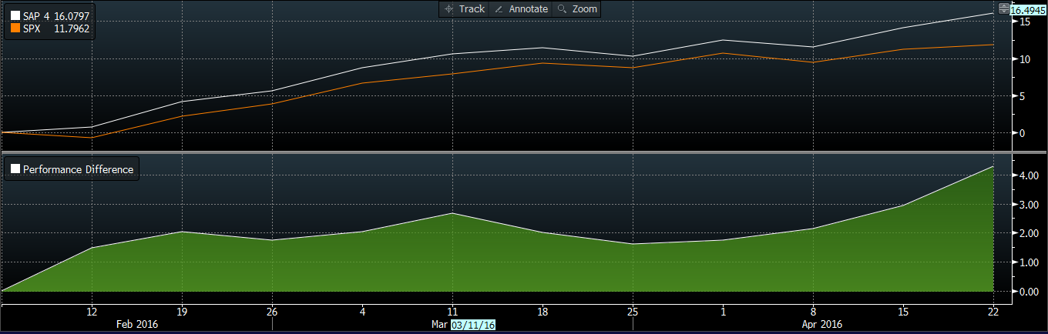
Portfolio Performance Spring Semester 2016
SAP Portfolio
13.95%
S&P 500
10.24%
Performance as of: (02/02/2016) – (04/27/2016)
Performance Difference
The bottom graph depicts the performance difference relative to the benchmark. Our portfolio outperformed early on, while experiencing turbulent market conditions in the recent months.

Slide 57
Portfolio Allocation
Information Technology 22.29 %
Health Care 13.37%
Apple Inc. 2.03%
Broadcom, Ltd. 3.52%
Cisco 4.22%
Facebook 2.14%
Flir Systems, Inc. 2.82%
Intel Corp 2.34%
Microsoft, Corp. 1.92%
Texas Instruments 2.16%
Technology ETF 1.15%
Johnson & Johnson 2.38%
Merck & Co. 3.16%
Gilead Sciences Inc. 2.20%
Anthem Inc. 2.00%
Becton, Dickinson and Company 1.54%
Abbott Laboratories 0.01%
Sucampo Pharmaceuticals, Inc. 2.07% 0.01%
Industrials 6.18%
Consumer Staples 13.41%
Stanley Black & Decker Inc. 3.29%
Southwest Airlines 2.24%
Industrials ETF 0.65%
Consumer Staples ETF 2.02%
Costco 4.03%
CVS Health Corp. 3.76%
Pepsico Inc. 0.97%
Estee Lauder Companies 2.64%
Consumer Discretionary 14.45%
Energy 11.45
Priceline 4.34%
Whirlpool Corporation 2.56%
Time Warner Inc. 2.47%
Starbucks Corporation 0.02%
New Media 2.23%
Johnson Controls Inc. 1.68%
Hasbro, Inc. 1.15%
Financials 18.13%
Energy ETF 9.80%
SeaDrill Partners LLC 1.65%
Financials ETF 7.95%
BlackRock 4.26%
MetLife, Inc. 3.69%
Regions Financial Co. 2.24%
Cash 0.72%

Slide 58
Portfolio Allocation
PORTFOLIO WEIGHTS
As of April 10, 2016

Slide 59
Sector Allocation
SAP vs. S&P 500
As of April 10, 2016

Slide 60
Performance Attribution
As of April 27, 2016
TOP OUTPERFORMERS
TOP UNDERPERFORMERS
SDLP | SeaDrill Partners LLC
SCMP | Sucampo Pharmaceuticals, Inc.
RF | Regions Financial
AAPL | Apple Inc.
SWK | Stanley Black & Decker
GILD |Gilead Sciences Inc.
HAS | Hasbro, Inc.
MET | MetLife, Inc.
AVGO | Broadcom, Ltd.
NEWM | New Media

Slide 61





TOP OUTPERFORMERS
Broadcom
Regions Financial
Hasbro
Stanley Black & Decker
SeaDrill

Slide 62
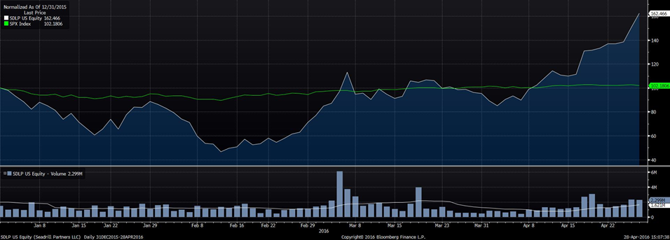

Top Outperformers
SEADRILL PARTNERS LLC| SDLP
Position
1600 Shares | $8,768
Throughout the semester, Seadrill saw an inherent gain of 59% in the month of April alone, and secured it as our top performer. The stock supplied % of the total return in the portfolio.
One important factor for Seadrill over the semester was that it was involved in multiple contracts with bigger oil companies. This allowed Seadrill to gain contracts and opportunities during a low point in the market. When oil prices started to rise,, Seadrill became very profitable again, as seen through their stock price.
Additionally, Seadrill’s long-dated contracts & significant backlog allowed for them to sustain its strong free cash flow. This served important for their recent success, especially during the down oil market. The purchase of Seadrill was quite risky, especially given the point in time the deal finalized. The oil market and conditions kept teeter-tottering and the middle eastern meetings did not provide much insight.. Future projections have Seadrill look bright with their British Petroleum contracts going into 2020.
Source: Bloomberg

Slide 63
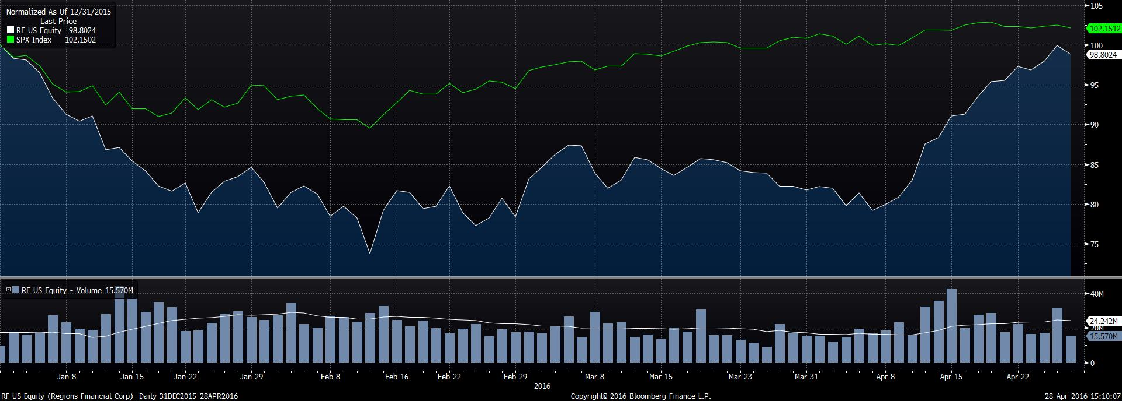

Top Outperformers
REGIONS FINANCIAL| RF
Position
1235 Shares | $ 11,856
Regions Financial throughout the semester was the second best performer, with a return of 22.5%. Regions began their comeback right after we purchased the stock and has been a great performer since.
In addition, Texas Instruments Inc. had trended downwards from early Spring to Fall bottoming out on August 25th. Rebounding after it released 3rd quarter results, they beat estimates by 13.43%. Also the company announced a $7.5 billion dollar share buy-back program along with an increase in its dividend from 34¢ to 38¢.
Going forward, we expect Texas Instruments Inc. to maintain its positive momentum. Driven by benefits from streamlining its business structure, continued growth in the semiconducting space fueled by analog and embedded processer.
Source: Bloomberg

Slide 64
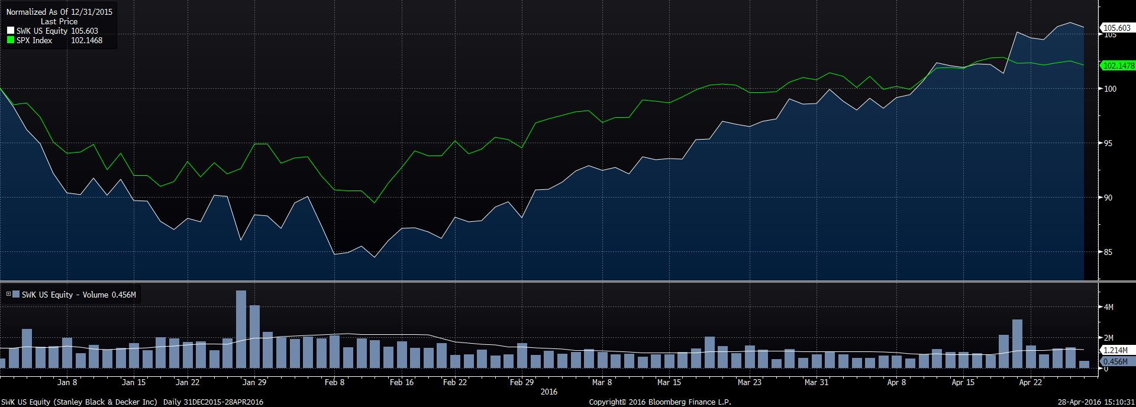

Top Outperformers
STANLEY BLACK & DECKER| SWK
Position
154 Shares | $17,390.02
Stanley Black & Decker ranked as our third top performer for the semester. Returns of over 21% led the industrial company to represent a contribution of % to the total return for the portfolio.
Stanley Black & Decker has been consistently outperforming Wall Street expectations showcased by beating earnings in eight consecutive quarters and has been profitable for nine straight. The consistency does not stop there, it has also been experiencing a steady rise of 70% in dividend payments since 2010.
Future projections of the stock have placed a price target at $130 for the forward twelve months. This target enables an additional 19% possible growth rate from the current price. Considering Stanley Black and Decker’s outperformance against expectations, we believe this projection may not even be high enough.
Source: Bloomberg

Slide 65

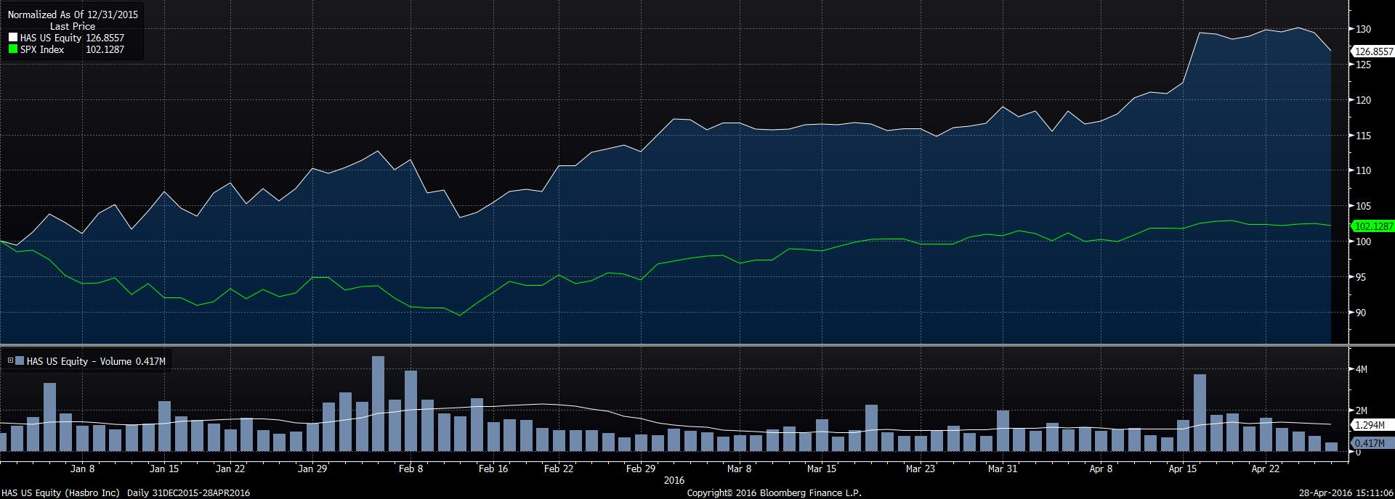
Top Outperformers
HASBRO, INC.| HAS
Position
70 Shares | $6,027
Hasbro Inc. turned out to be our fourth best performer. Hasbro contributed a return of 18.85%. Hasbro falls under the consumer discretionary sector and continually beat the S&P 500 throughout the semester, by as much as 10%.
Hasbro attested many highlights during the calendar year. First, being the undeniable success of the Star Wars franchise, and the plentiful amount of toys they were able to profit off of. Second, was their impressive earnings reports. During the amount of time in the portfolio, Hasbro had two earnings reports that exceeded expectations. The earnings in February rose 7%, whereas in April they resulted in a monstrous 58.33%.
Lastly, the trend of consumers holding onto their money played a big role in the consumer discretionary sector. This sector was one of few that provided continuous gains during the semester. It proved true that many consumers spent their money sparingly in a down market.
Source: Bloomberg

Slide 66

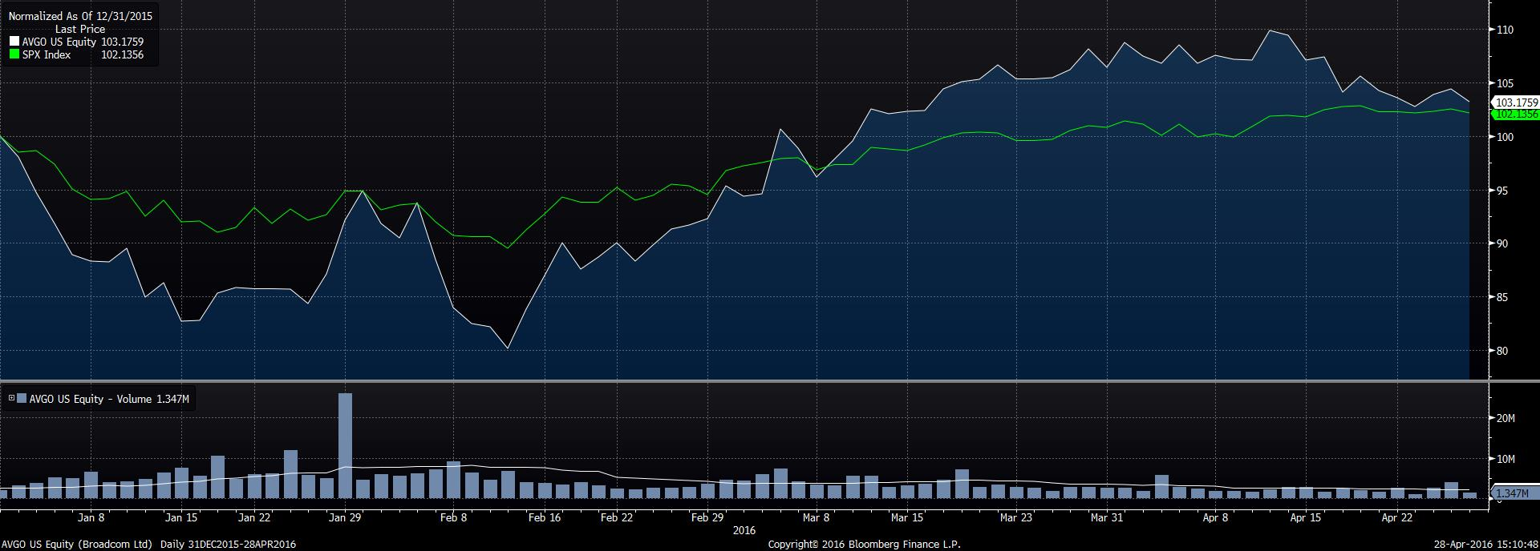
Top Outperformers
BROADCOM, LTD. | AVGO
Position
123 Shares | $18,750.12
Broadcom ranked as our fifth top performer for the semester. Returns of over 16% led the information technology sector. Broadcom even beat the S&P 500 by 9% during the time we invested in the stock.
Broadcom has been consistently outperforming Wall Street expectations showcased by beating earnings in four consecutive quarters. Broadcom was our most consistent stock, and provided profitable gains during its entire time in the portfolio.
We bought the stock at the perfect time, right around its 52 week low, and we were able to profit off of all the stocks recent success. A big reason for there success, was through there recent mergers and acquisitions wit other telecommunication companies. This synergy has allowed Broadcom to enter in more diverse markets and gain more market share. Future projections of the stock can be seen through the strengths, such as its compelling growth in net income, largely solid financial position with reasonable debt levels by most measures and good cash flow from operations.
Source: Bloomberg

Slide 67





TOP UNDERPERFORMERS
New Media
MetLife
Gilead Sciences
Apple
Sucampo Pharmaceuticals

Slide 68
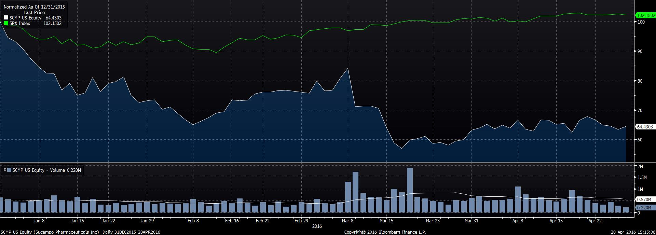

Top Underperformers
SUCAMPO PHARMACEUTICALS INC. | SCMP
Position
1000 Shares | $11,220
Sucampo was our worst performer to date, resulting in a spiraling -16.781%. It is hard to believe, but the stock actually performed even worse at points throughout the semester, reaching an abysmal low of -33.84%. As you can see on the graph to the left, we bought the stock just before it came tumbling down.
Healthcare was one of the hardest sectors hit during our time of managing the portfolio. This was mostly due to the politics regarding the 2016 presidential debates and the lackluster price of oil.
Another major reason the stock did so poorly was because its drug missed its primary endpoints in a phase 2a trial. We had high hopes on Sucampo successfully moving onto the next trial. However, we knew this was a risky play and ended up costing the portfolio quite a bit of money in the process.
Source: Bloomberg

Slide 69

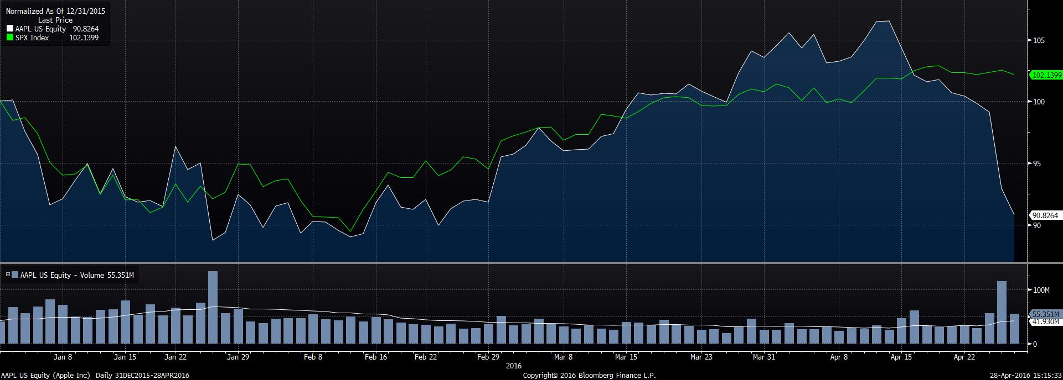
Top Underperformers
APPLE INC. | AAPL
Position
109 Shares | $10,647.25
Apple Inc. actually did fairly well throughout the harsh market conditions we faced. However, during the last month, the stock started to slip and resulted with a decline of -12.087%.
Much of Apple’s recent failure came from their declining iPhone sales. Apple’s 13-year run of quarterly revenue growth ended in late April, a casualty of Apple’s already immense size, weakness in key global markets like China and the lack of another hot product to pry open the wallets of customers. Apple sold 16% fewer iPhones in the quarter compared with the same quarter last year.
To the public’s surprise as well as ours we were shocked by this news, as Apple has been such a great stock to own over the last couple years. Most of that success is equated from iPhones sales ironically. We believe this regression in sales is due to their popular iPhone 6 model. Since, fall of 2014 the iPhone has not changed much as well as the release of their new product lines, like the apple watch and new iPad Pro.
Source: Bloomberg

Slide 70
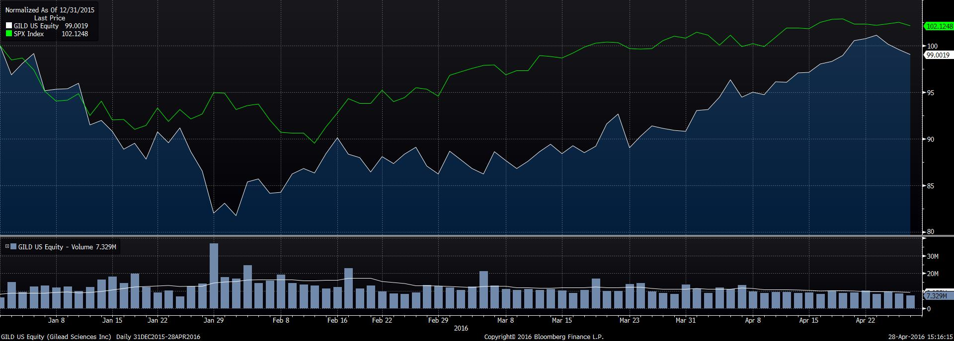

Top Underperformers
GILEAD SCIENCES INC. | GILD
Position
115 Shares | $ 11,570
Gilead Sciences was our third worst performer. The stock was only had a negative return of -2.653%, but also fell under the declining healthcare sector.
The stock was doing alright, until the market was hit hard by the struggling oil prices. As every sector got hit hard from these troubling times, healthcare saw some of the worst affects. It’s strange that Gilead performed so poorly after releasing strong earnings and beating estimates by 12%. Gilead also released strong revenue from their Hepatitis C drug.
However, in the later months Gilead was involved in a patent case with Merck over their Hepatitis C drug. The outcome of the case, resulted in Gilead Sciences' stock dropping 2.8% premarket after losing the patent case. This was devastating to Gilead, and was one of the sole reasons the stock did so poorly.
Source: Bloomberg

Slide 71
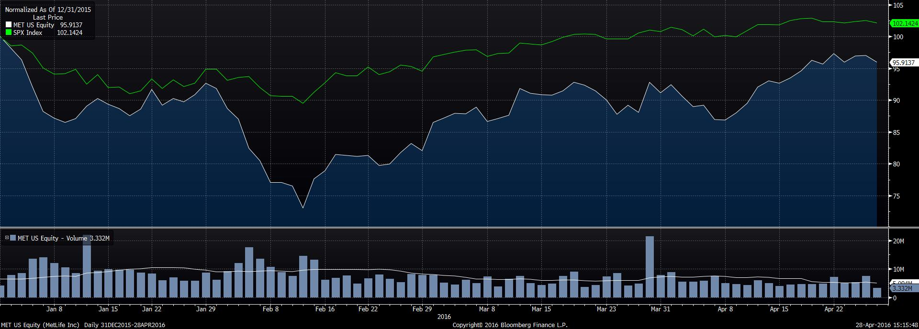

Top Underperformers
METLIFE INC. | MET
Position
418 Shares | $ 19,356
MetLife Inc. came in as our fourth worst performer. The stock ended with a return of 1.599%. During our time of handling the portfolio, we saw all of MetLife’s losses and barely any gains. MetLife bottomed out at $35.21, one of it’s worst closing prices in over five years.
Going along with the poor market trend, financials was another sector that got hit very hard. MetLife, also released poor quarter four revenues, along with weak earnings. MetLife’s Q4 revenue was $17.11 billion vs $18.25 billion and MetLife’s Q4 earnings 70 cent a share vs $1.30 a share compared to the prior year.
MetLife Inc.'s fourth-quarter earnings fell sharply, as it wrestled with tough economic conditions in many parts of the world, while low interest rates continued to work against insurers. MetLife became the latest insurer to cite faltering performance of private-equity and hedge funds as a factor in its earnings, which were below analysts' consensus expectations. The company also reported weaker profit margins in many of its core insurance underwriting businesses. MetLife also saw waning, as a result of, the strong U.S. dollar.
.
Source: Bloomberg

Slide 72
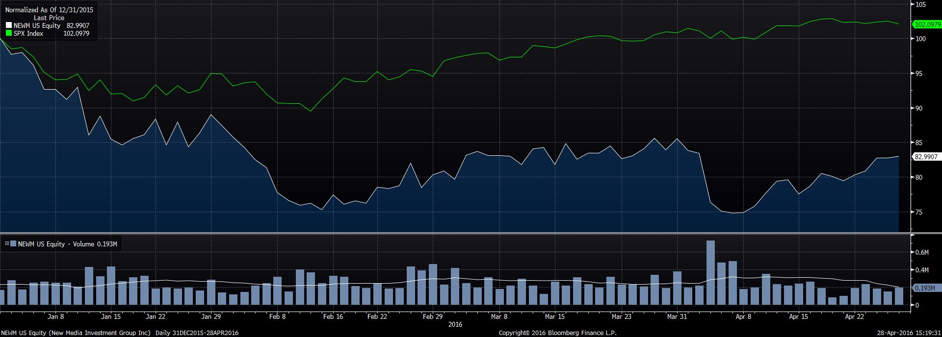

Top Underperformers
NEW MEDIA | NEWM
Position
733 Shares | $11,925
New Media Investment Group finished as our fifth underperformer. New Media produced a negative return of -1.529%. In the stocks defense, we only had the stock in our portfolio for less than a month, and is almost back to the acquisition price.
We missed buying the stock at close to its 52 week low by three days, and resulted in this loss. Although, we only owned the stock for such a shirt period of time, it was still surprising the company still do so poorly. This was a shock, considering it falls under the Consumer Discretionary sector, which was one of the best performing sectors all semester.
One of the main reason for the drop in stock price, was due to Citigroup’s downgrade of the stock. Another contributing factor was that New Media breached its 50 day moving average in a Bearish Manner on April 6th.
Source: Bloomberg

Slide 73
Student biographies
Spring 2016
Overview
Economic Conditions
Portfolio Strategy & Composition
Sector Summaries
Risk Analysis
Performance Review
Student Biographies

Slide 74


Biographies
Derek is an undergraduate student pursuing a Bachelors of Business Administration with a double concentration in International Business and Finance at Loyola University Maryland. He is a member of the Sellinger Scholars, Alpha Sigma Nu, and the Financial Management Association Honor Society. Derek previously interned with Morgan Stanley and SC&H Group and will begin working for Capco as an Associate Consultant in June, 2016.
Derek J. Anderson
Jillian is an undergraduate student pursuing a Bachelors of Business Administration with a concentration in Finance and a minor in Computer Science at Loyola University Maryland . Jillian is from Bel Air, Maryland and is related to Will Smith. Jillian is currently an incoming full-time analyst at Goldman Sachs, and will begin working at the firm in July, 2016.
Jillian T. Harper

Slide 75


Biographies
Tim is an undergraduate student pursuing a Bachelors in Business Administration with a concentration in Finance at Loyola University Maryland. Tim is a member of Loyola’s Sellinger Scholar’s Program, Alpha Sigma Nu Chapter, and the Financial Management Association National Honors Society. Tim has previously interned with Crystal & Company, Tobia & Hillyer Financial Services, LLC, and VMS Aircraft Co. In his hometown of Caldwell, NJ , Tim volunteers as an Emergency Medical Technician. He also enjoys spending time with friends and family while relaxing on the beautiful Jersey Shore.
Timothy R. Kelly
C.J. is an undergraduate student pursuing a Bachelors in Accounting and a Bachelors in Business Administration with a concentration in Finance at Loyola University Maryland with an expected Summa Cum Laude status. In addition to his undergraduate studies, C.J. has interned for EY in NYC where he will be working fulltime starting in January, 2017.
Christopher J. Kutner

Slide 76


Biographies
Jamahn is an undergraduate student pursuing a Bachelors of Business Administration with a concentration in Finance at Loyola University Maryland. Aside from his studies, Jamahn is a member of Loyola’s Sellinger Scholars Program, the men’s club basketball team, the Financial Management Association and the ALANA mentoring program. He has previously held internships with JMI Equity, EY, and T. Rowe Price. Following graduation, Jamahn will be working with Stifel in Baltimore as an associate analyst in their equity research division. In December 2016, He will pursue the CFA charterholder and sit for the Level I exam.
Jamahn C. Lee
Malorie is an undergraduate student pursuing a Bachelors of Business Administrationwith a concentration in Finance at Loyola University Maryland . Accompanying her studies, she is a part of the Beta Gamma Sigma Honor Society and the Financial Management Association Honor Society. Malorie previously interned with Maller Wealth Advisors and is now a full-time Performance Analyst at Brown Advisory. In her free time, she enjoys playing soccer and spending time with friends and family.
Malorie K. Moran

Slide 77
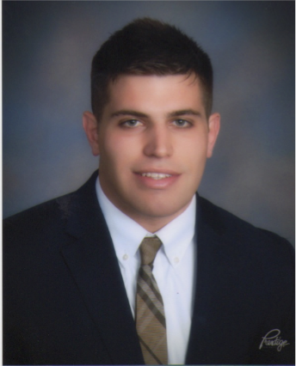

Biographies
Matt is an undergraduate student pursuing a Bachelors of Business Administration with a concentration in Finance and minors in Information Systems and Spanish at Loyola University Maryland. In addition to his studies, Matt is a member of Loyola's FMA chapter and the Loyola Club Rugby team. Matt is also licensed as a Real Estate Salesperson and the Vice President of the Real Estate Club. He has also previously interned with OneMain Financial in a risk management position. Originally from Boston, Matt claims that he deflated Tom Brady's footballs.
Matthew D. Nader
Chris is an undergraduate student pursuing a Bachelors of Business Administration with a concentration in Finance at Loyola University Maryland. Aside from his studies, Chris is involved with Loyola’s Financial Management Association, Microfinance club, and Study Abroad Ambassadors. He also has prior experience working with Morgan Stanley and Domino Foods, Inc.
Christopher R. Nelson

Slide 78


Biographies
Dan is an undergraduate student pursuing a Bachelors of Business Administration with a concentration in Finance at Loyola University Maryland. He is expected to graduate cum laude and is a member of the FMA National Honor Society, served as the CFO of Loyola’s Student Government Association, and competed as part of a five-person team in the CFA Institute Research Challenge. In addition to academics and extracurricular, Dan has interned with Legg Mason and Deloitte – upon graduating, Dan will return to Deloitte in NYC as a consultant.
Daniel D. Polizzano
Sean is an undergraduate student pursuing a Bachelors of Business Administration with a concentration in Finance at Loyola University Maryland. In addition to his studies, Sean has interned for an accounting firm in Westchester, NY and is a member of the Loyola Chapter of the Financial Management Association. Outside the classroom, people seem to like him because he is polite, rarely late, and really enjoys a nice pair of slacks.
Sean J. Pryor

Slide 79


Biographies
Matt is an undergraduate student pursuing a Bachelors of Business Administration with a concentration in Finance and a minor in Information Systems at Loyola University Maryland . In addition to his studies, Matt is a member of Loyola’s Financial Management Association chapter and previously held an internship with Raymond James in Philadelphia for two consecutive summers. After graduation in May 2016, He will return to his hometown of Philadelphia to join the Vanguard Group as a Client Relationship Specialist. ​
Matthew J. Quigley
Mike is an undergraduate student pursuing a Bachelors of Business Administration with a double concentration in Economics and Finance at Loyola University Maryland . In addition to his undergraduate studies, he is a member of the Fixed Income Society and Study Abroad Ambassadors. Originally from Medfield, Massachusetts, Mike has interned with Westwood Global Investments & Hellman Jordan Management. He is a die-hard Bostonian where he will return after graduation.
Michael C. Ray

Slide 80


Biographies
Madison is an undergraduate student pursuing a Bachelor of Science in Statistics with a concentration in Actuarial Science and a minor in Business. Madison is originally from Darien, CT and upon graduation, will be returning where she will work as an Actuarial Analyst in the Retirement sector at Mercer.
Madison H. Smith
Kevin is an undergraduate student pursuing a Bachelors of Business Administration with a triple concentration in Finance, Business Economics, and International Business, with a minor in Philosophy at Loyola University Maryland . He is also a member of Beta Gamma Sigma and Vice President of the Adam Smith Society. Upon graduation, he will be working as an Associate Performance Analyst at Brown Advisory in Baltimore. He is an avid shark enthusiast and enjoys drinking Shirley Temples at elitist locations along the eastern shoreline.
Kevin J. Smith

Slide 81


Biographies
Tony is an undergraduate student pursuing a Bachelors of Business Administration with a concentration in Finance and a minor in Information Systems at Loyola University Maryland. Tony is from Wilton, Connecticut and is currently a member of the Financial Management Association. In addition to his studies, Tony interned at Northwestern Mutual and Terex Corporation. After graduation in May 2016, Tony will return to Terex Corporation as an International Tax Intern. Tony will also be pursuing an MBA in Finance at Fairfield University come Fall 2016. He is a food connoisseur that hopes to revive and star in Man v. Food.
Antonio J. Tomas
Mark is undergraduate student pursuing a Bachelors in Accounting and a Bachelors of Business Administration with a concentration in Finance. In addition to his studies, Mark is a member of the Sellinger Scholar's Program as well as Beta Alpha Psi, an accounting honor society. Upon graduation, Mark will begin working for Ernst & Young in Denver, Co. as a member of their Audit and Advisory team. Aside from being a glutton for excessive workloads, Mark enjoys all aspects of the outdoors and short walks to the fridge.
Mark D. Tracy

Slide 82




